Slide 1
7FNCE040W
Business Analytics
Multiple Regression & Dummy Variables
WEEK 4 BITE 1

Slide 2
From last week In-Class/Extra Problem
Open Meddicorp.sav
Run the requested regressions & answer the questions
Be prepared to discuss your answers

Slide 3
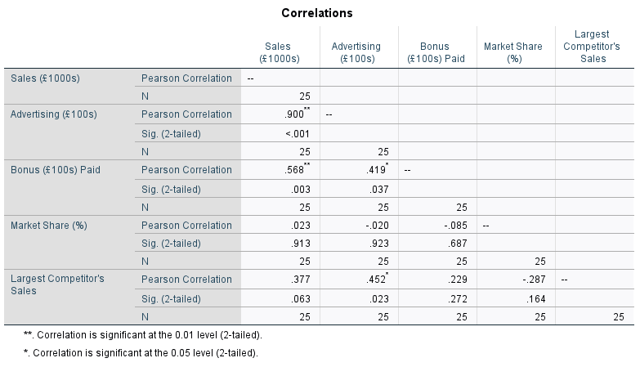
Correlation matrix
Notes:
Note strongest association is with 10 advertising, 2) Bonuses both market share and largest competitor are not sig (@5%)

Slide 4
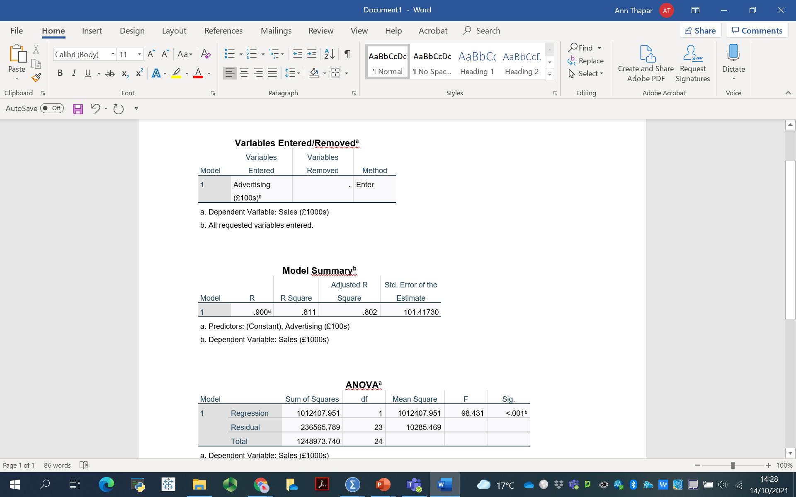
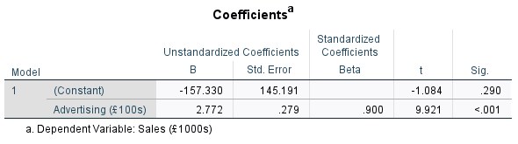
Part 1: 1st Regression Model 1 Sales(£000’s)= -157.3 +2.77(Advertising, £00’s)
Notes:
Note constant is not sig here adj Rsq = 0.802

Slide 5
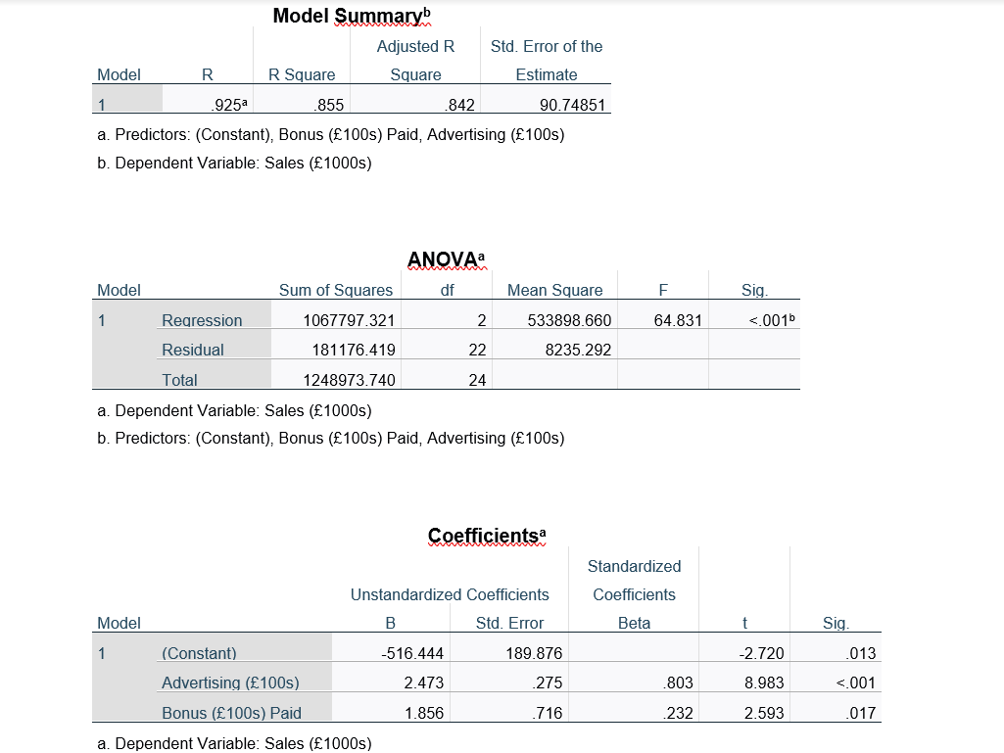
Part 2: 2nd Regression Sales(£000’s)= -516.44 +2.47(Advertising, £00’s) + 1.85 (Bonus, £00’s)
Notes:
Place your output in this slide and save for later reference.
Now adj R-sq = 0.842 ( so slight improvement with 2 IV , both are significant
Interpret this model

Slide 6
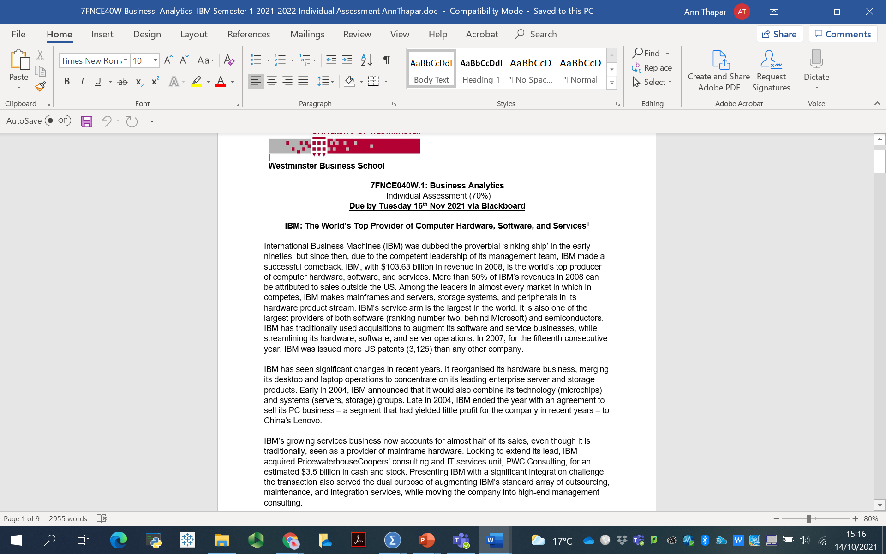

Reminders
INDIVIDUAL
70 % weighting
Notes:
Please be aware that this assessment must be completed individually. In the past, this has been a problem and students were penalised.
Please don’t leave this for the last minute.
Certainly chi-square, t-tests, and ANOVA tests can be performed, where appropriate.
While there may be more regression insights that can be applied, initial regressions can already be performed with what has been covered already.
Any questions on the assessment?

Slide 7
Assessment
1
2
3
Describe the respondents of the questionnaire.
Develop a model (or 2) to predict
Make a recommendation regarding the insights revealed from your analysis and its contribution to Marketing Management decisions
Notes:
As noted in the assessment brief, think about what might be of key interest to management. Based on frequencies, chi-square tests, and tests of means, are there any initial findings that would be of particular interest to management?
Think about the key concern that IBM have must be able to retain its customer base. Is it working, what is not?
Write a memo to IBM’s management that details what you learned and defend it with your data analyses. Keep in mind that management at IBM wants to know how it can keep its customers from going to competitors.

Slide 8
Writing A Memo
Content
Justification / Support
Introduction
Brief description of situation
Brief recommendation
Full details of analysis
Details & support of recommendation / key findings
Feel free to make your own tables
Relevant SPSS output should appear in an appendix
Need to provide evidence from analyses
Explain what you learned –not what you did
Explain and show the equation estimated
Explain why certain variables were included
Interpret findings
Link findings to the recommendation

Slide 9
Today’s Schedule
Dummy Variables
Problems in Regression
Transforming Variables
Notes:
In addition to learning more about employing regression, these topics will also show how SPSS can be used to create new variables. This may be useful knowledge for one or both of the assessments.

Slide 10
Dummy Variables

Slide 11
Regression Uses Numbers
Many occasions when we want non-metric (categorical / nominal) explanatory variables in equation
Can’t use words in regression
Dummy (or Indicator) variable
Variable acts as a replacement for text
Dummy variable represents one category (or level) of the nominal or ordinal variable
1 if the observation is in the category
0 otherwise
Notes:
Some potential explanatory variables are categorical and cannot be measured on a quantitative scale.
However, we often need to use these variables because they are related to the response variable.
The trick is to create dummy variables, also called indicator or 0-1 variables.
These are variables that indicate the category a given observation is in.

Slide 12
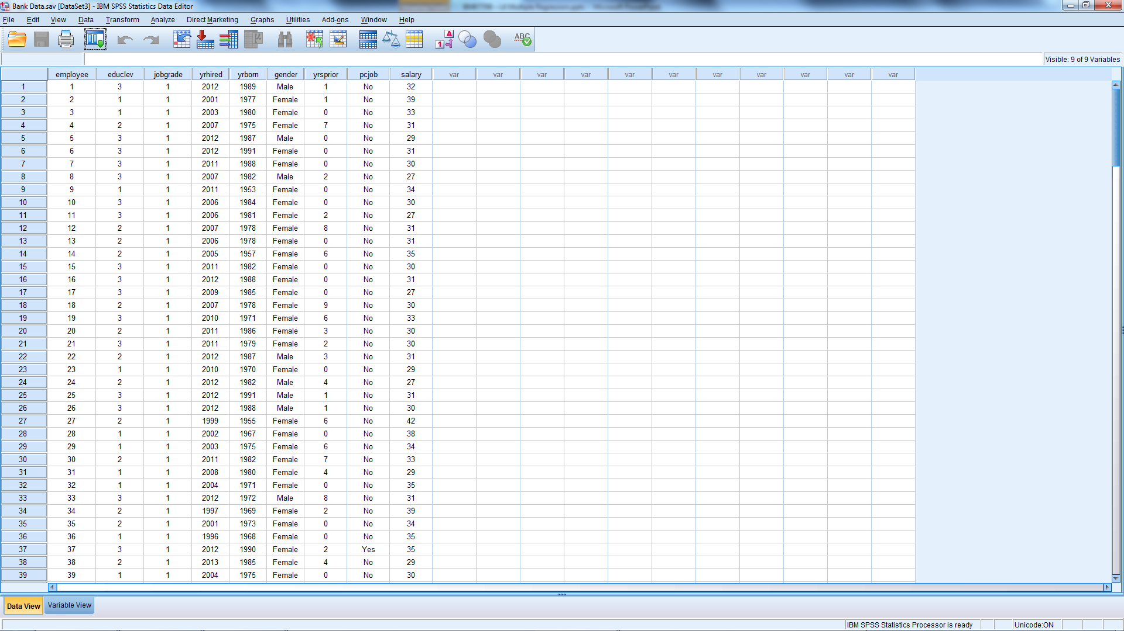
Gender Discrimination Suit
Open Bank Data.sav
Notes:
Open Bank Data.sav
For each of the 208 employees, the data set includes the following variables:
EducLev: education level, a categorical variable with categories 1 (Less than UG), 2 (Some UG studies), 3 (UG degree), 4 (Some PG studies) and 5 (PG Degree)
JobGrade: a categorical variable indicating the current job level, the possible levels being from 1-6 (6 is highest)
YrHired: year employee was hired
YrBorn: year employee was born
Gender: a categorical variable with values “Female” and “Male”
YrsPrior: number of years of work experience at another bank prior to working at the current bank
PCJob: a dummy variable with value 1 if the employee’s current job requires data entry and / or analysis and value 0 otherwise
Salary: current annual salary in thousands of GBPs

Slide 13
Where to start?
What are we trying to predict?
Name one critical independent variable.
What will be our first model?
Predicted Salary = b₀ + (b₁* gender)
How will we know if women are paid less than men?

Slide 14
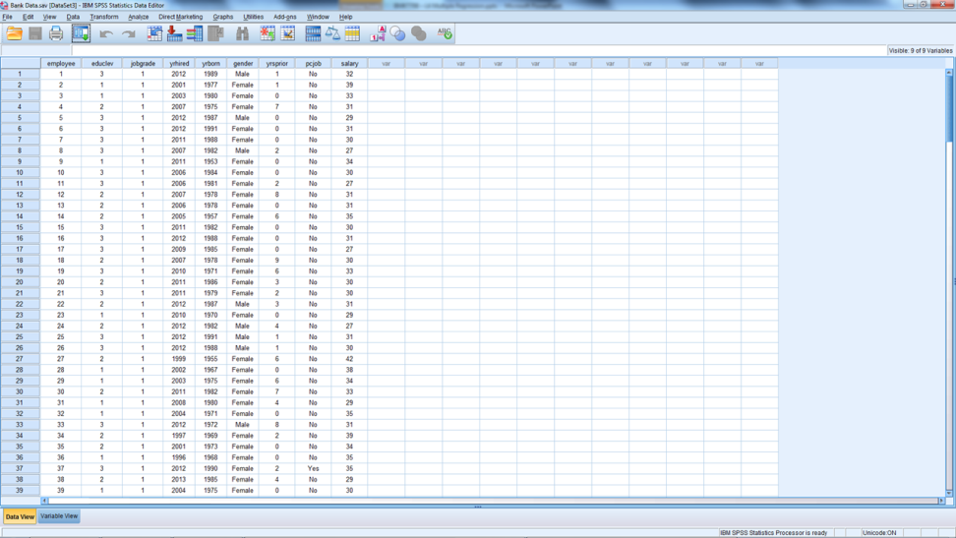
Gender Variable – Problem?
Notes:
Gender → Indicator (Dummy) Variable
1 = in the category
0 = not in the category
Transform
Recode Into Different Variables
Use Different variable (rather than same) so that you never loose original data

Slide 15
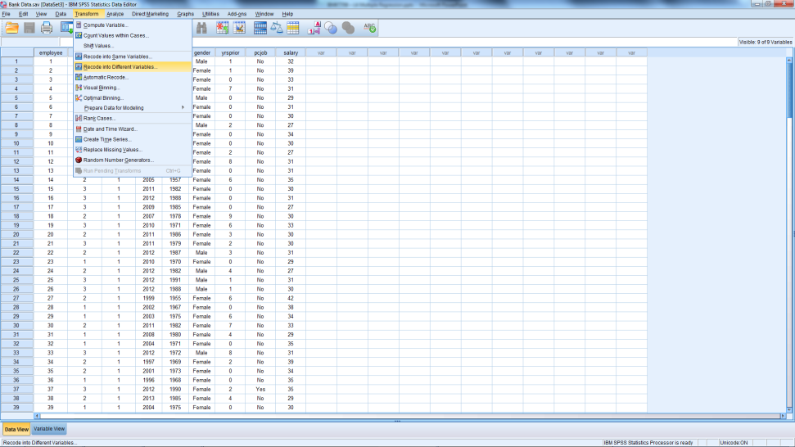
Gender Variable – Problem?
Notes:
Gender → Indicator (Dummy) Variable
1 = in the category
0 = not in the category
Transform
Recode Into Different Variables
Use Different variable (rather than same) so that you never loose original data

Slide 16
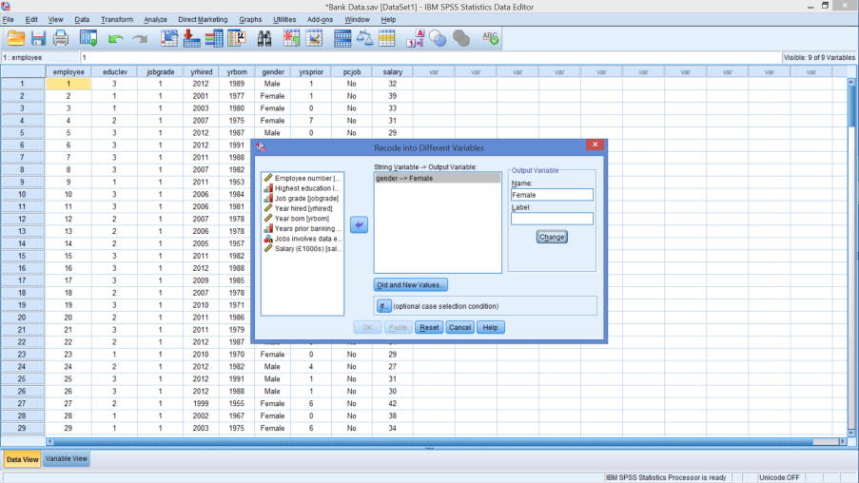
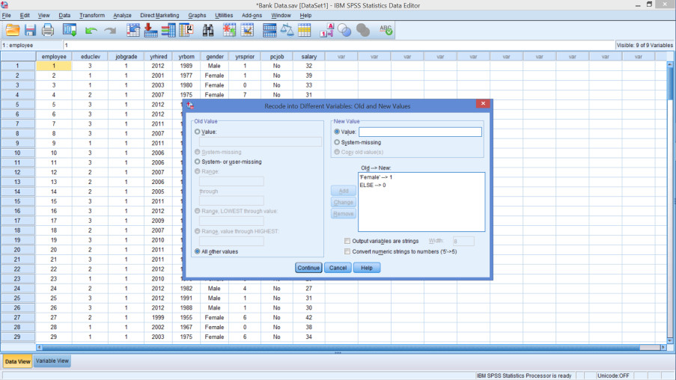
Create ‘Female’ Variable
Gender → Female
Old & New Values
Notes:
Select ‘Gender’ then arrow
In NAME type Female
Hit Change
Hit Old and New Values
Next Screen
Old Value: Female New Value: 1 Then ‘Add’
Tick ‘All other Values’ New Value: 0 Then ‘Add’
Then ‘Continue’
Then ‘OK’
Note: When identifying the ‘old’ value – this must match exactly; watch upper versus lower case, spaces, punctuation/symbols, etc.

Slide 17
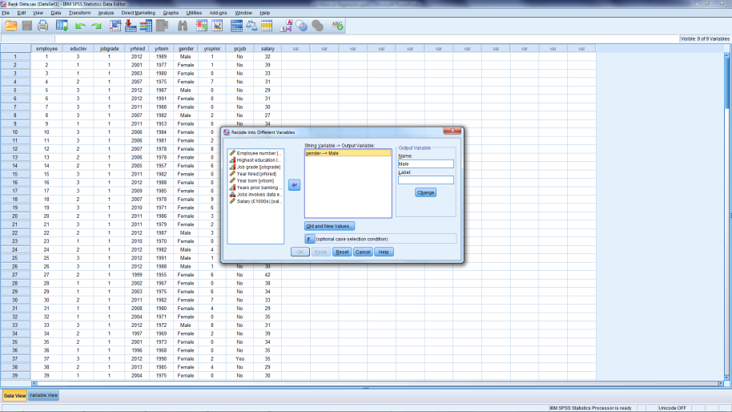
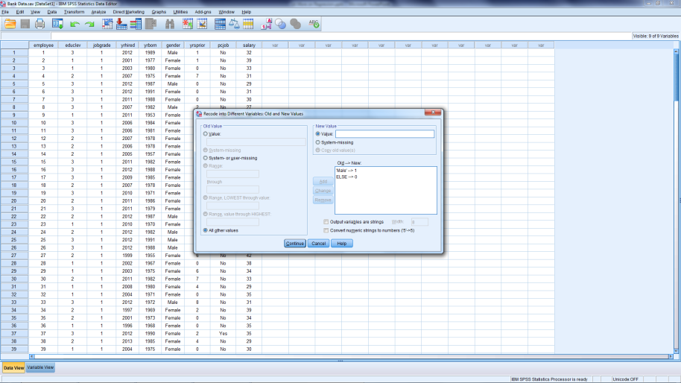
Create ‘Male’ Variable
Gender → Male
Old & New Values
Notes:
Hit Reset to clear the previous change
Select ‘Gender’ then arrow
In NAME type Male
Hit Change
Hit Old and New Values
Next Screen
Old Value: Male New Value: 1 Then ‘Add’
Tick ‘All other Values’ New Value: 0 Then ‘Add’
Then ‘Continue’
Then ‘OK’
Note: When identifying the ‘old’ value – this must match exactly; watch upper versus lower case, spaces, punctuation/symbols, etc.

Slide 18
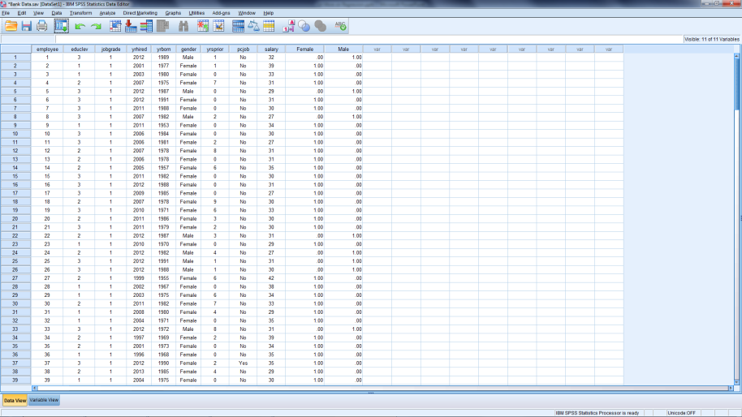
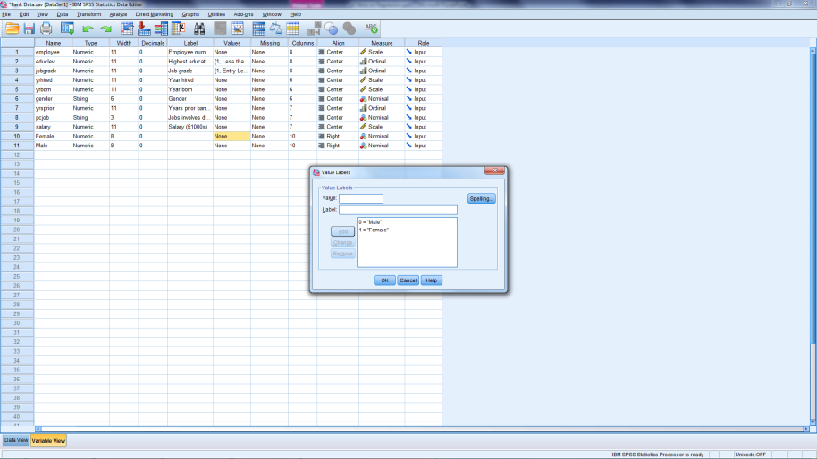
Data File with New Variables
Data View
Variable View
Notes:
Variable view (if desirable)
Set decimal places to 0
Could center alignment
Define variables for Female as:
1 = Female
0 = Male
Define variables for Male as:
1 = Male
0 = Female

Slide 19
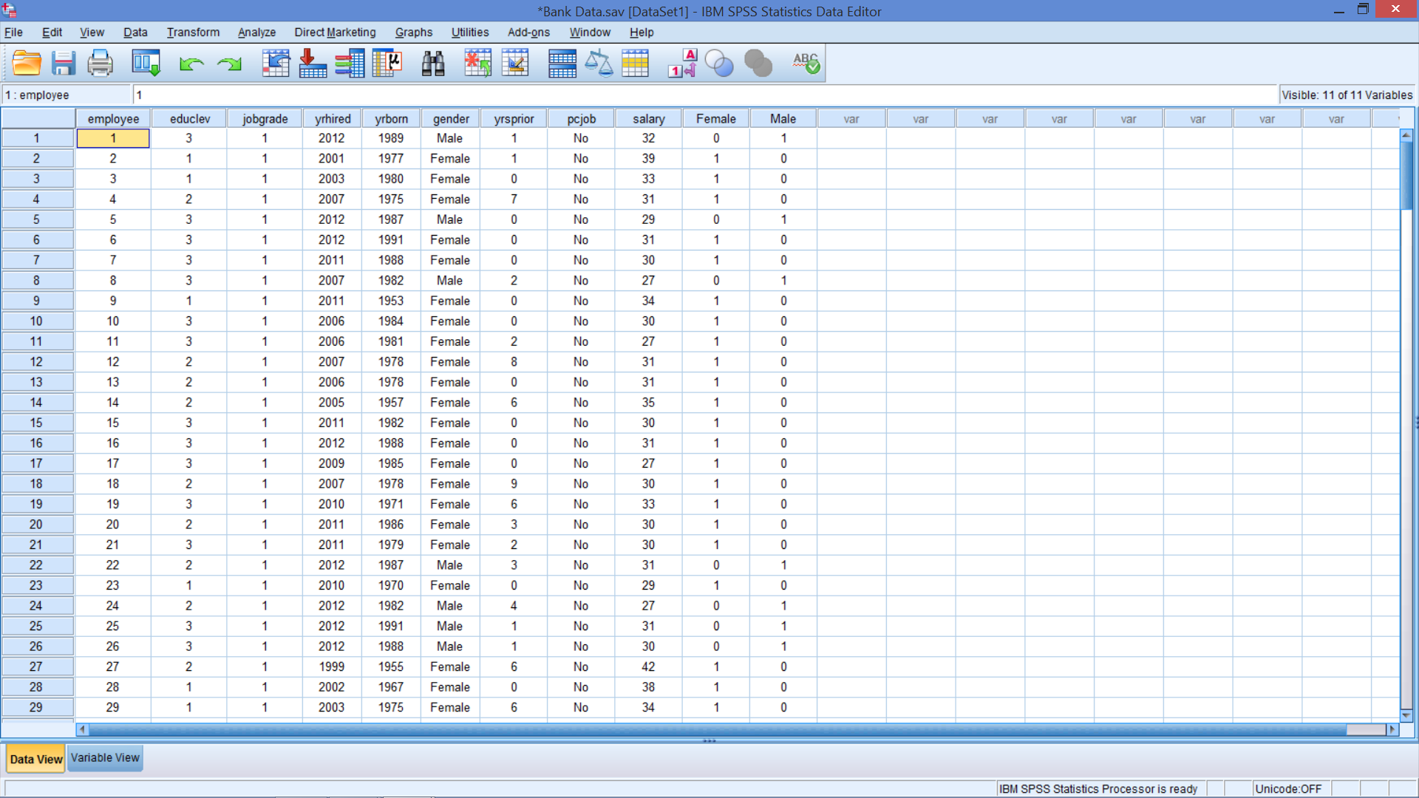
New Data File

Slide 20
Regression – Consider 2 Rules
1
Cannot use the original categorical variables
Only use new dummy / indicator variables
2
Use one less dummy variable than the number of categories (levels) for the original nominal variable
The missing category of the variable is referred to as the reference category
Captured in the intercept (constant)
Notes:
This second rule is a technical one. If we violate it the software will give us an error message.
For example, gender actually has 2 categories, so any one of these variables can be used.
For a future example, education has 5 categories, so any one of these variables can be left out
However, it makes sense – with ordinal data – that the highest or lowest category be the reference category to ease interpretation.
The omitted dummy then corresponds to the reference category.
As we will see the interpretation of the coefficient on the dummy variable is with respect to the reference category.
To get used to dummy variables in regression analysis we will proceed in several stages.

Slide 21
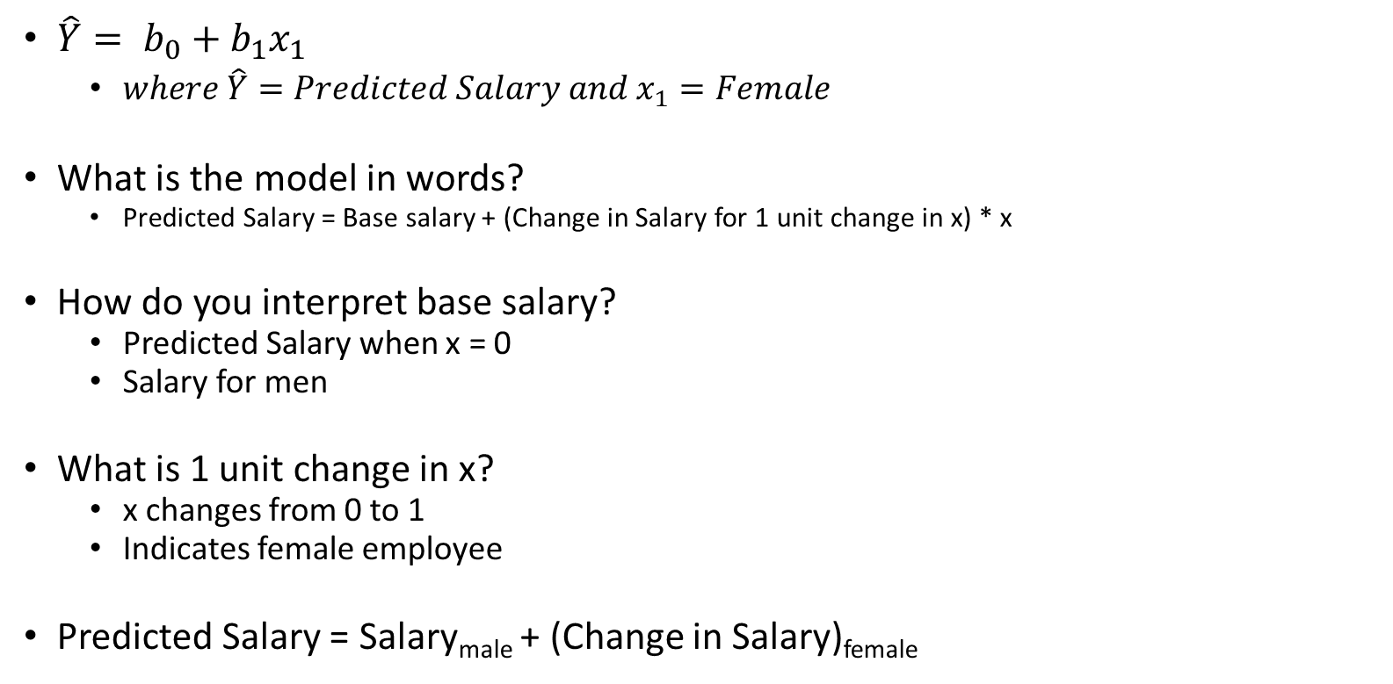
Interpreting the Regression Equation
$\hat{Y}= b_{0}+b_{1}x_{1}$
$where {\hat{Y}=Predicted Salary and x}_{1}=Female$
What is the model in words?
Predicted Salary = Base salary + (Change in Salary for 1 unit change in x) * x
How do you interpret base salary?
Predicted Salary when x = 0
Salary for men
What is 1 unit change in x?
x changes from 0 to 1
Indicates female employee
Predicted Salary = Salary_{male} + (Change in Salary)_{female}

Slide 22
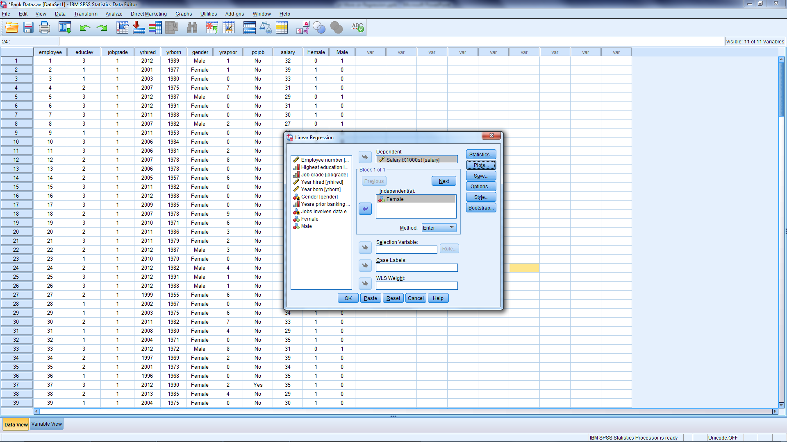
Preliminary Investigation
Analyze
Regression
Linear
Run a regression
Dependent: Salary
Independent: Female
Notes:
Analyze
Regression
Linear
Run a regression
Dependent: Salary
Independent: Female

Slide 23
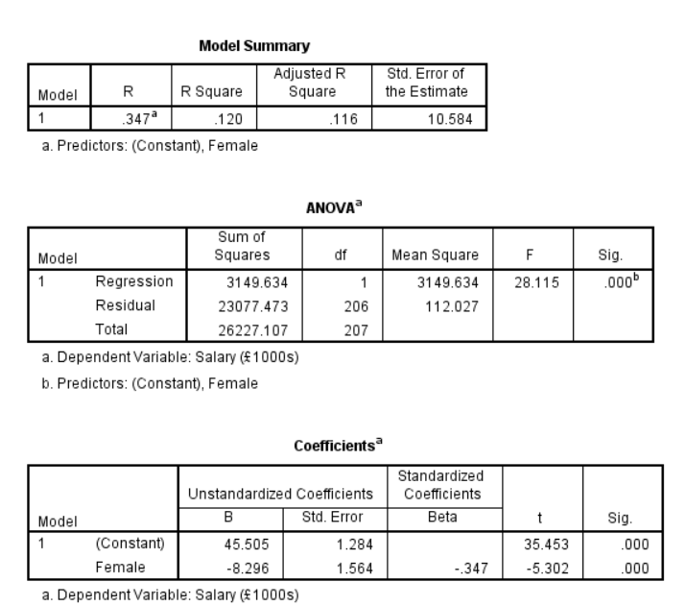
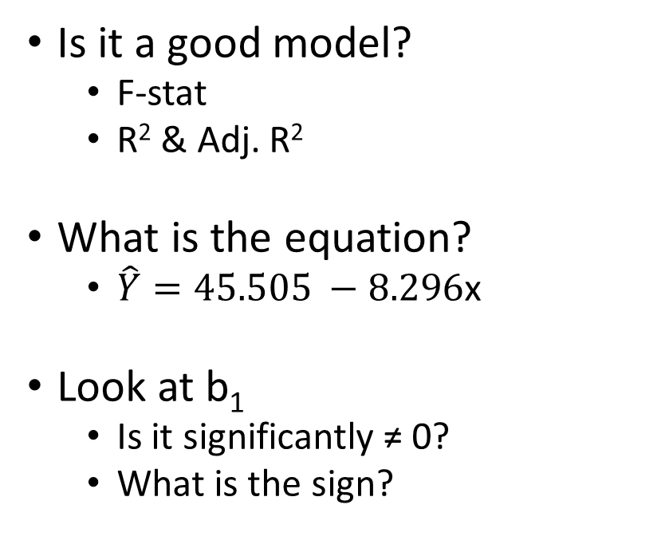
Do men make more than women?
Is it a good model?
F-stat
R² & Adj. R²
What is the equation?
$\hat{Y}=45.505 −8.296$x
Look at b₁
Is it significantly ≠ 0?
What is the sign?
Notes:
To interpret this equation recall that Female has only two possible values, 0 and 1.
If we substitute 1 then the predicted salary equals 37.209
If we substitute 0 the predicated salary is 45.505
These are the average salaries of females and males.
Therefore the interpretation of the -8.926 coefficient of the Female dummy variable is the difference in salary if the employee is female.

Slide 24
Do men make more than women?
How is b₁ interpreted?
What is salary if:
x = 0? 37.209
x = 1? 45.505
These are the average salaries of females and males.
Therefore the interpretation of the -8.926 coefficient of the Female dummy variable is the difference in salary if the employee is female.
Is this good news for the bank?
Could the difference be attributed to another factor?
Notes:
To interpret this equation recall that Female has only two possible values, 0 and 1.
If we substitute 1 then the predicted salary equals 37.209
If we substitute 0 the predicated salary is 45.505
These are the average salaries of females and males.
Therefore the interpretation of the -8.926 coefficient of the Female dummy variable is the difference in salary if the employee is female.

Slide 25
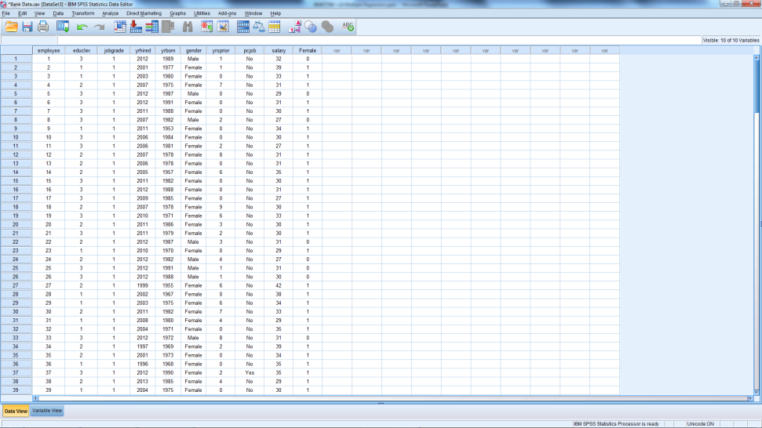
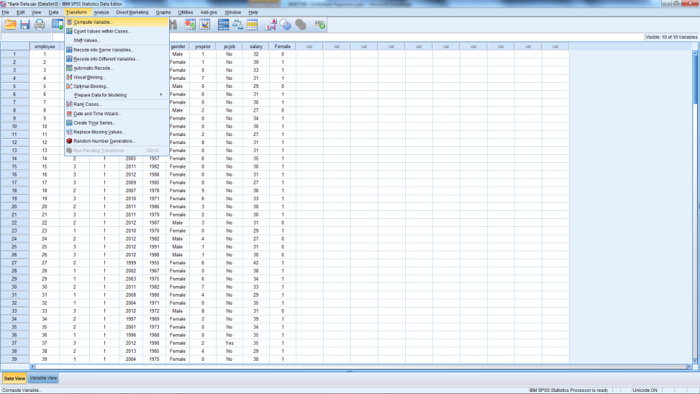
Add Years At Bank
Any Problems?
Compute New Variable

Slide 26
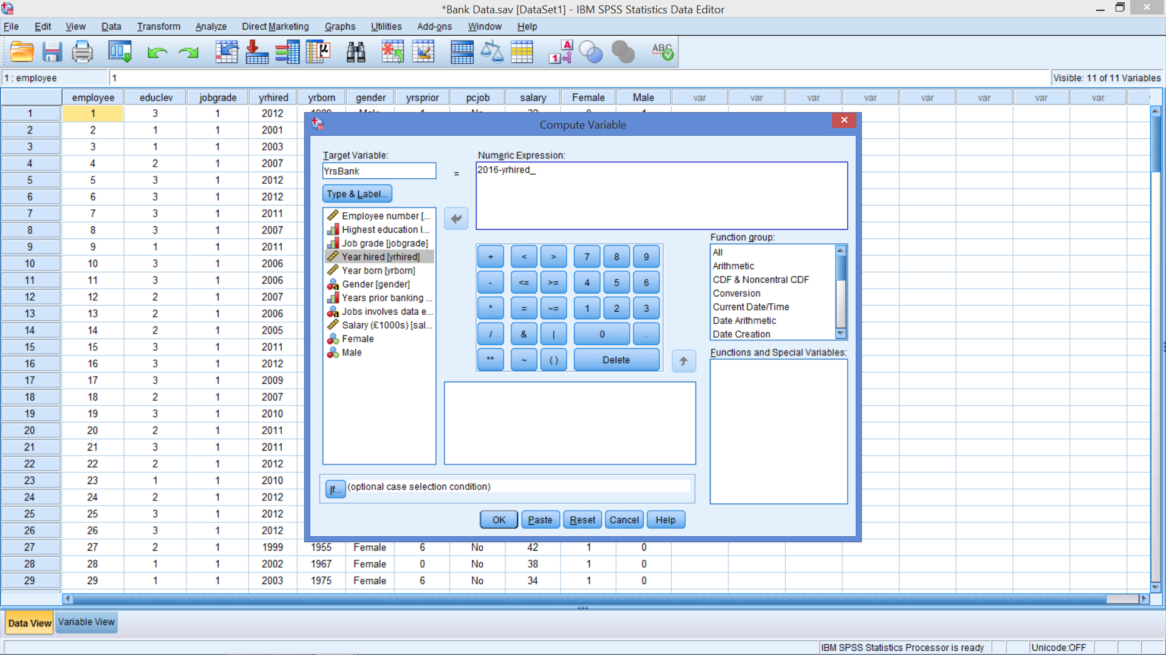
Create YrsBank Transform → Compute Variable In Target Variable: Insert the variable name I used YrsBank In Numerical Expression: Type in 2016 – yrhired ->Then use arrow to insert Year hired Hit OK
Notes:
Transform → Compute Variable
In Target Variable:
Insert the variable name
I used YrsBank
In Numerical Expression:
Type in 2016 – yrhired
Then use arrow to insert Year hired
Hit OK

Slide 27
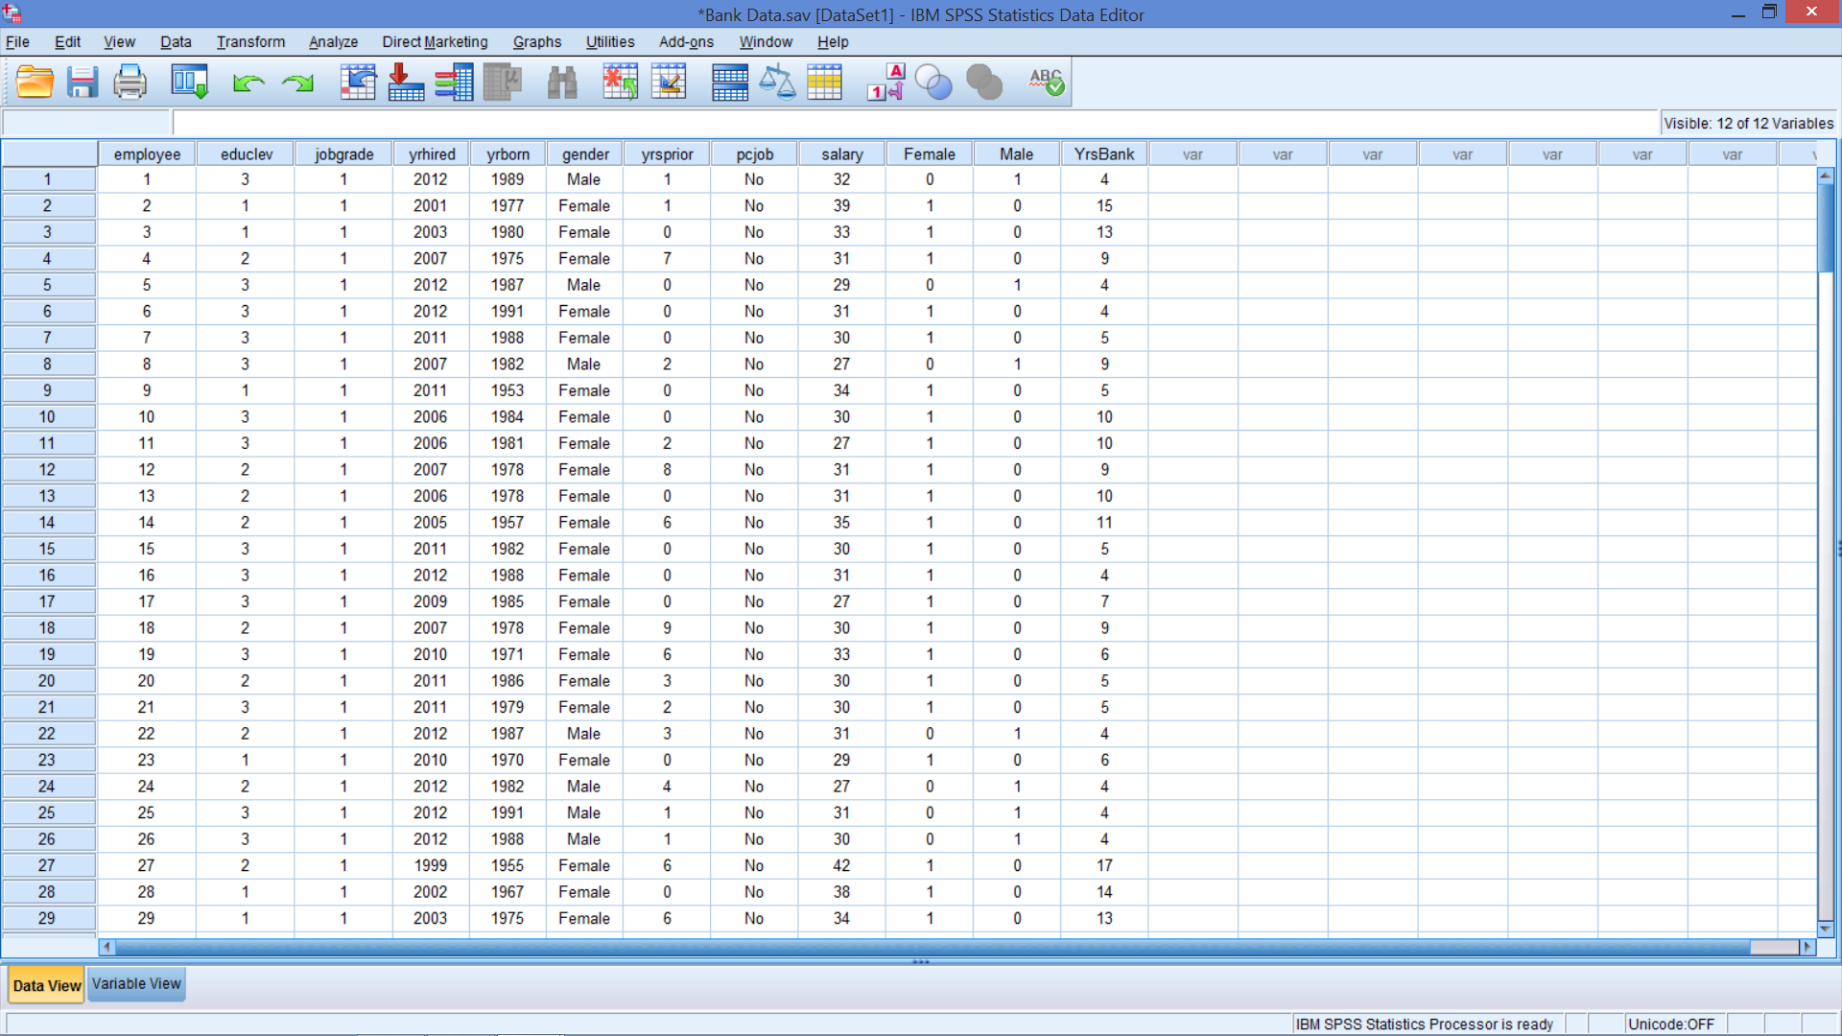
New Variable in Data View
Notes:
In variable view may adjust:
Decimal places (0)
Label (Years at the Bank)
Columns (7)
Alignment (Center)

Slide 28
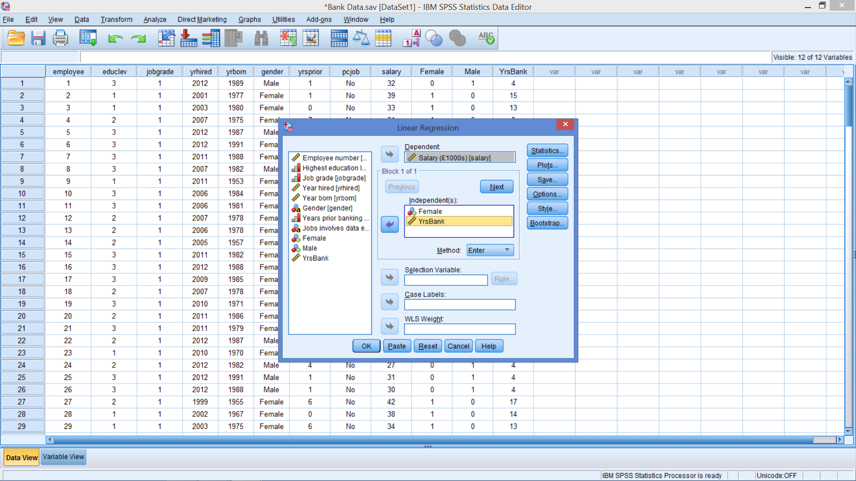
Add YrsBank to Regression

Slide 29
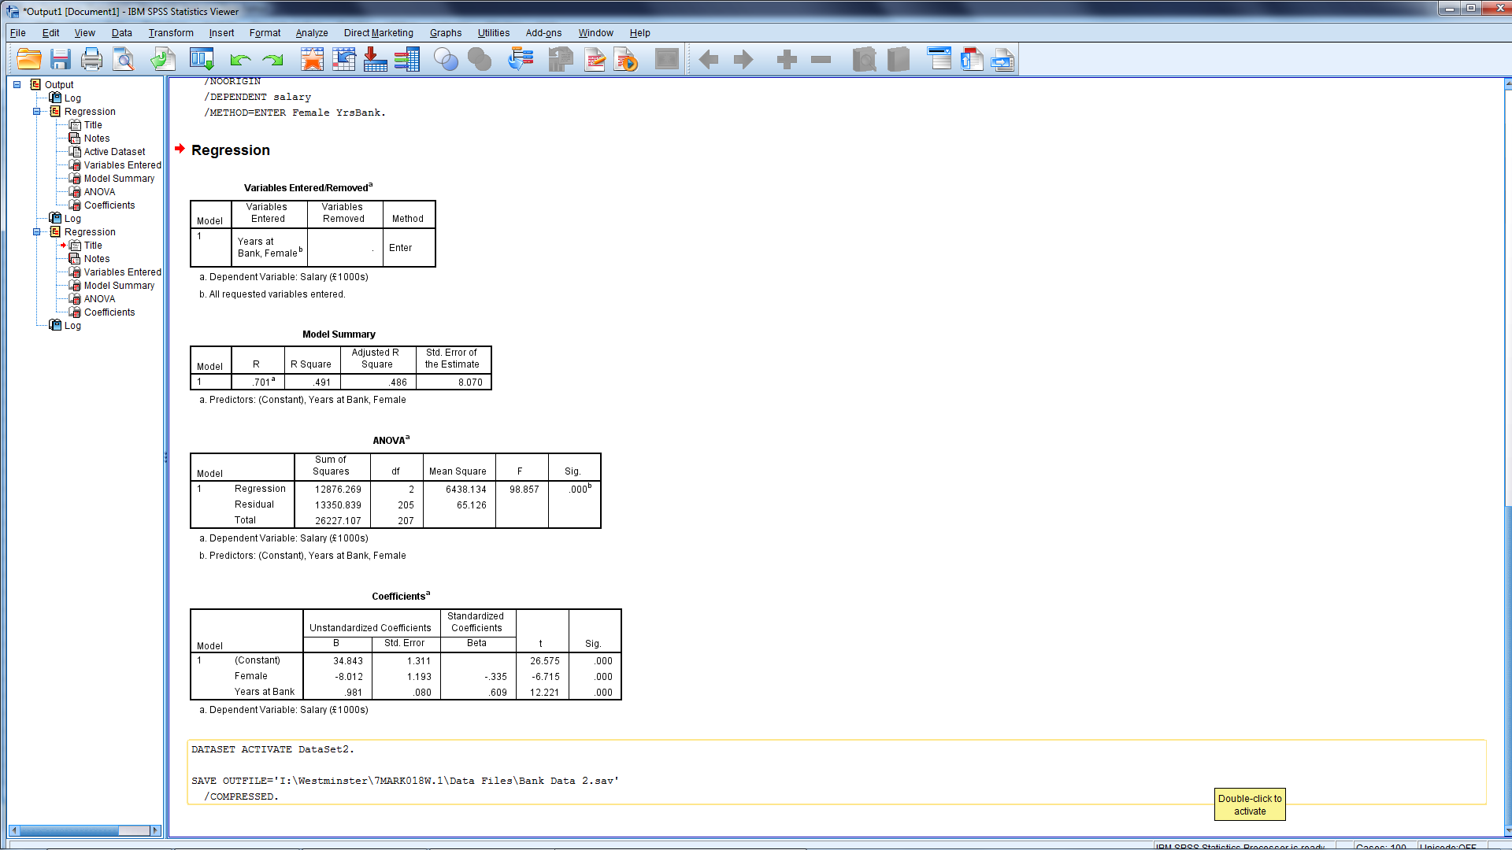
New Regression - Good News?
Something good in the model?
Is it better than the last model?
R²?
Adjusted R²?
Are the parameters significant?

Slide 30
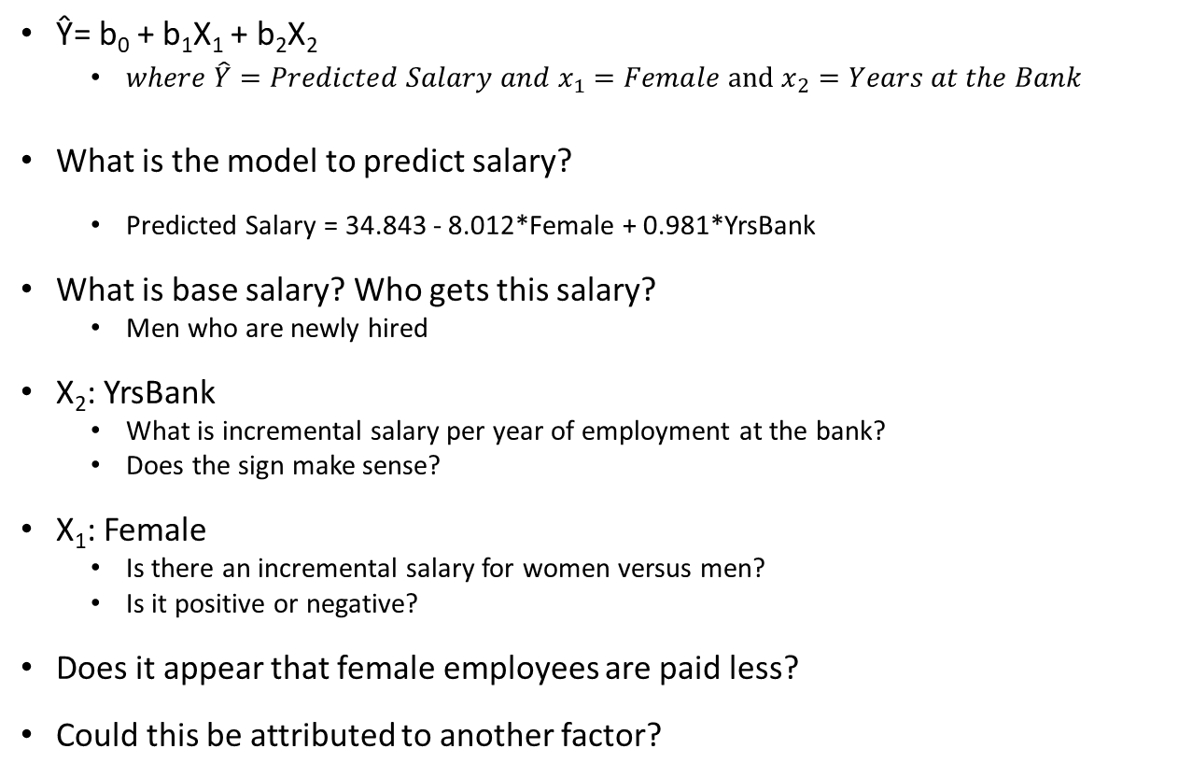
Interpreting Coefficients
Ŷ= b₀ + b₁X₁ + b₂X₂
$where {\hat{Y}=Predicted Salary and x}_{1}=Female and x_{2}=Years at the Bank$
What is the model to predict salary?
Predicted Salary = 34.843 - 8.012*Female + 0.981*YrsBank
What is base salary? Who gets this salary?
Men who are newly hired
X₂: YrsBank
What is incremental salary per year of employment at the bank?
Does the sign make sense?
X₁: Female
Is there an incremental salary for women versus men?
Is it positive or negative?
Does it appear that female employees are paid less?
Could this be attributed to another factor?

Slide 31
End of Bite 1 BREAK 10 mins

Slide 32
Wk 3 Bite 2 Cont…
Dummy variables
Now introducing Education

Slide 33
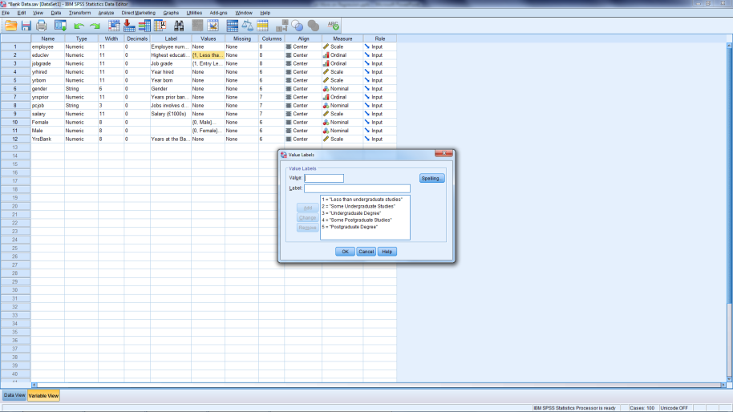
Recognising Education
What type of variable?
Although numbers
Don’t measure quantities
Can’t be used in regression
Create 5 variables
1 = In category
0 = Not in category
Notes:
EducLev is a 5-level variable: Indicates Highest level of education
EducLev = 1: Less than UG
EducLev = 2: Some UG
EducLev = 3: UG Degree
EducLev = 4: Some PG
EducLev = 5: PG Degree
See Value column in variable view sheet

Slide 34
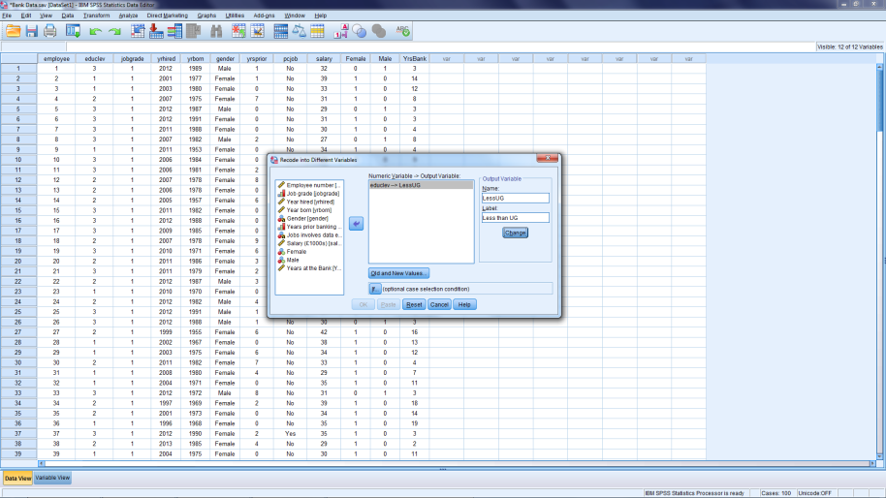
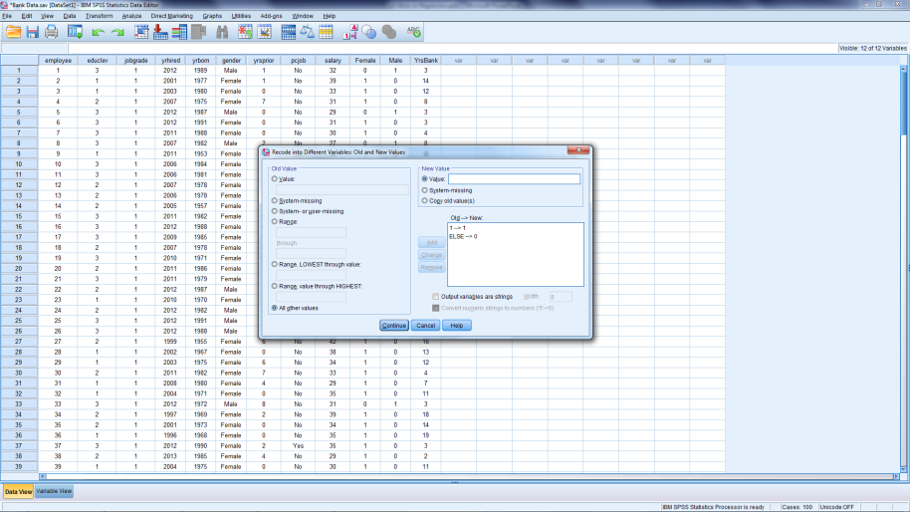
Method 1: Recoding Education
Recode into Different Variable
Old & New Values
Notes:
Need 5 categories
For each Category
= 1 if in the category
= 0 otherwise
Transform
Recode Into Different Variables
Click on reset (if necessary)
Select EducLev then arrow
In NAME type: LessUG
IN LABEL type: Less than UG
Hit Change
Hit Old and New Values
Next screen:
Old value: 1 New value: 1 Hit Add
All other values New value: 0 Hit Add
Hit Continue
Hit OK
Repeat for each level of education (2 through 5)

Slide 35
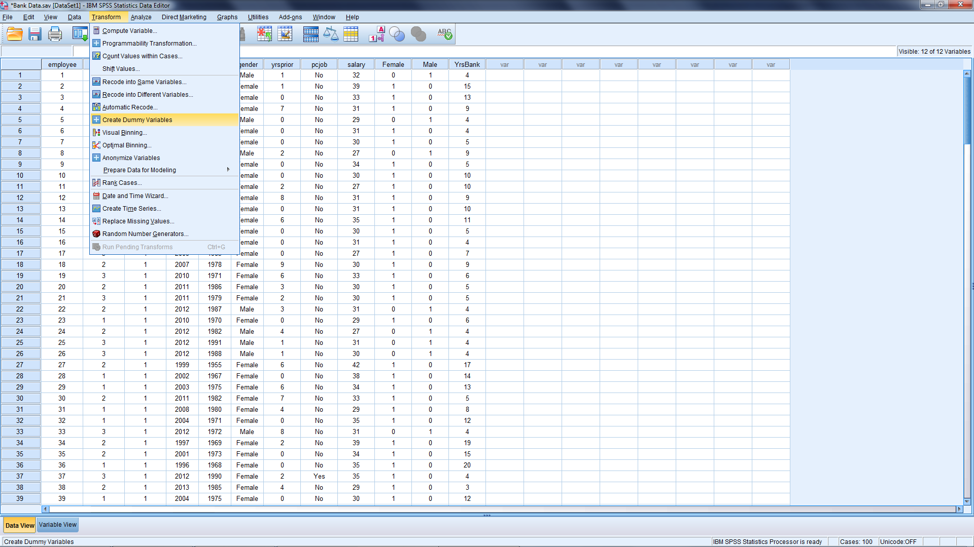
Method 2: Use SPSS option

Slide 36
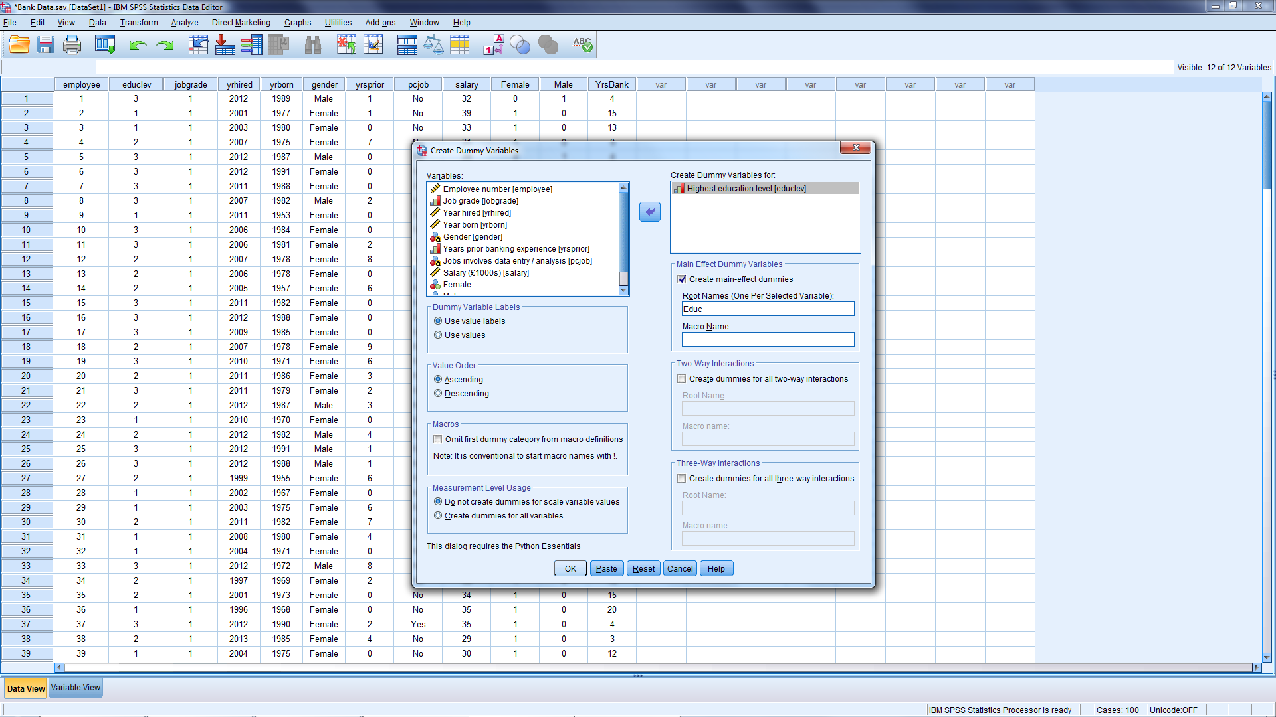
Creating for Education

Slide 37
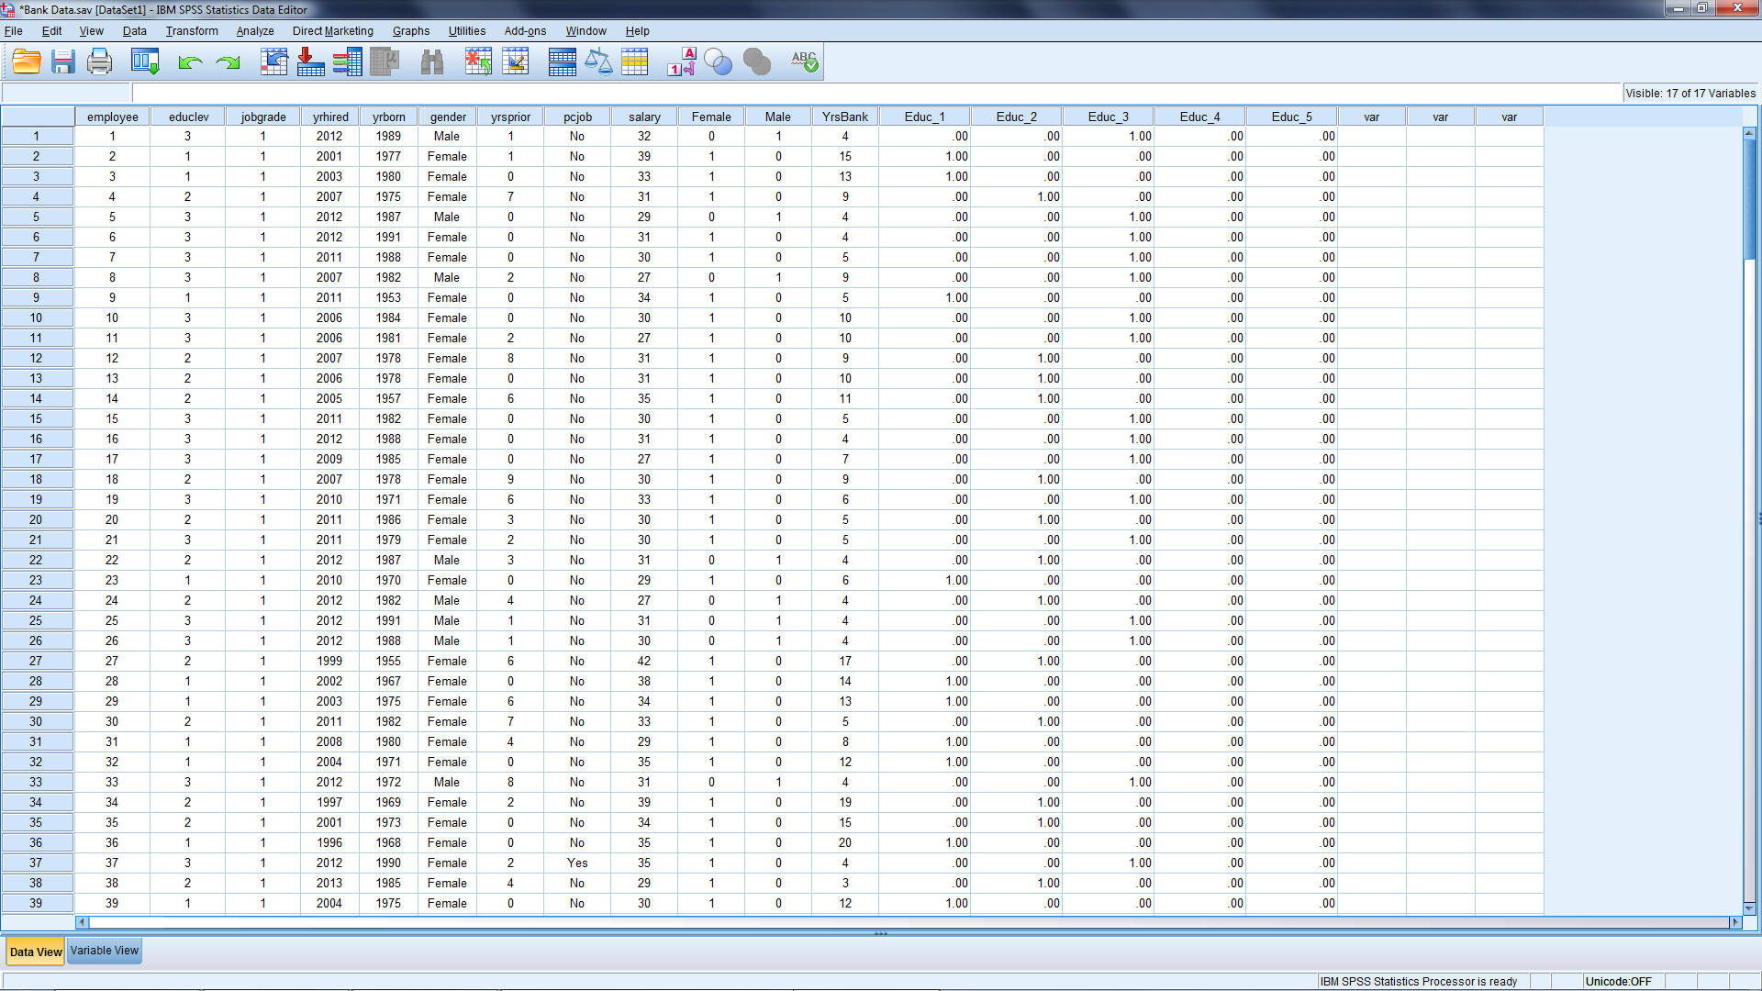
New Data File

Slide 38
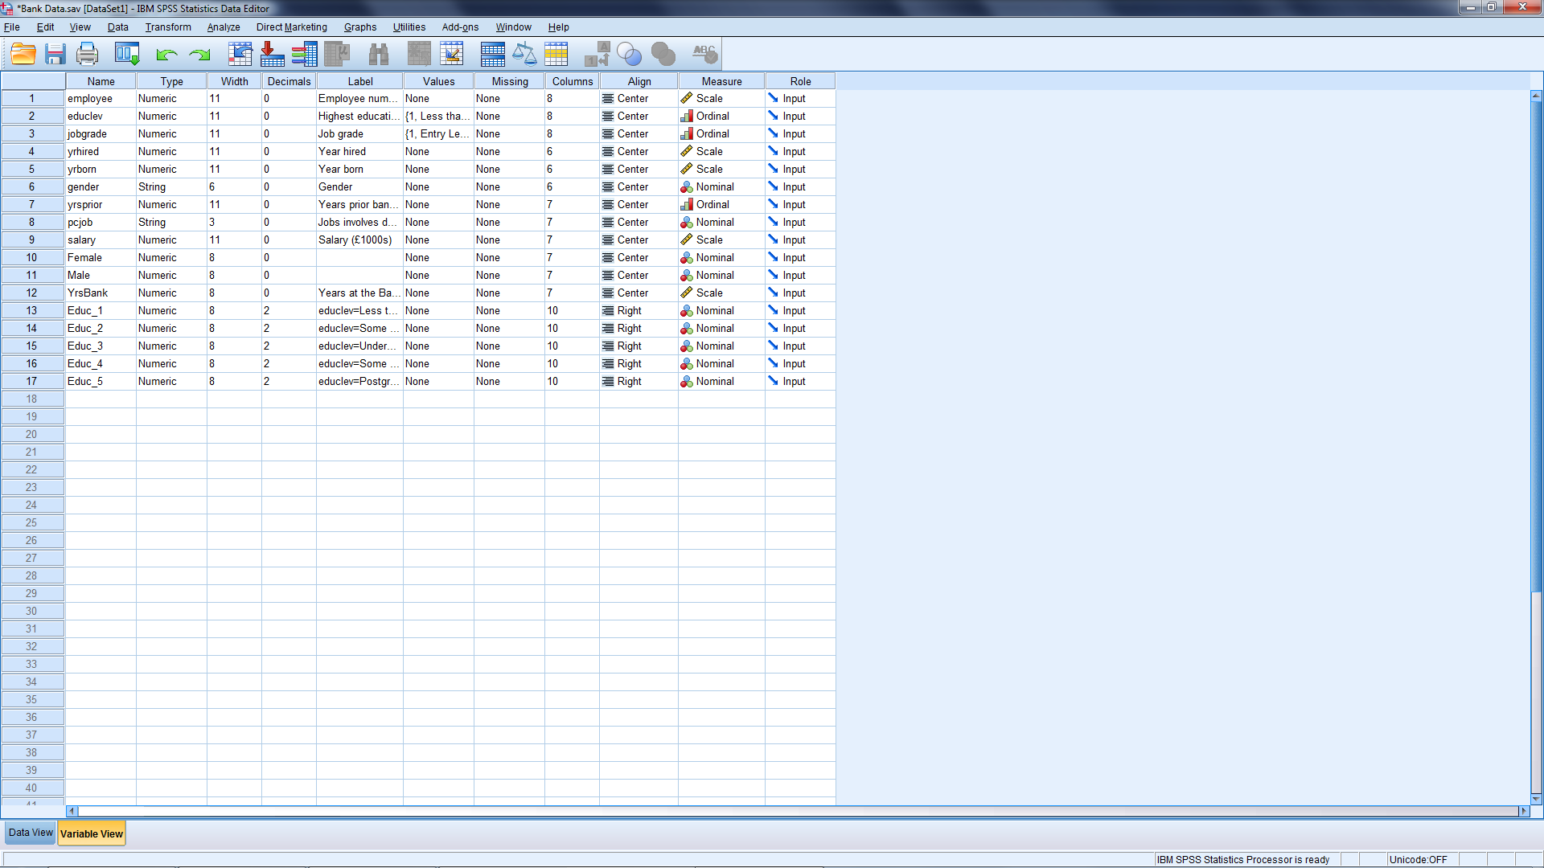
Improve from Variable View
Notes:
Improve by better defining:
Name
Decimals
Label
Columns
Alignment

Slide 39
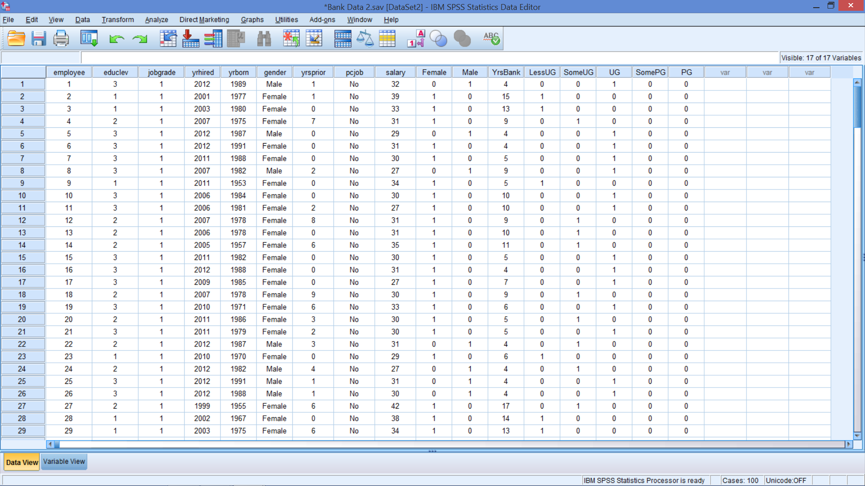
New Variables

Slide 40
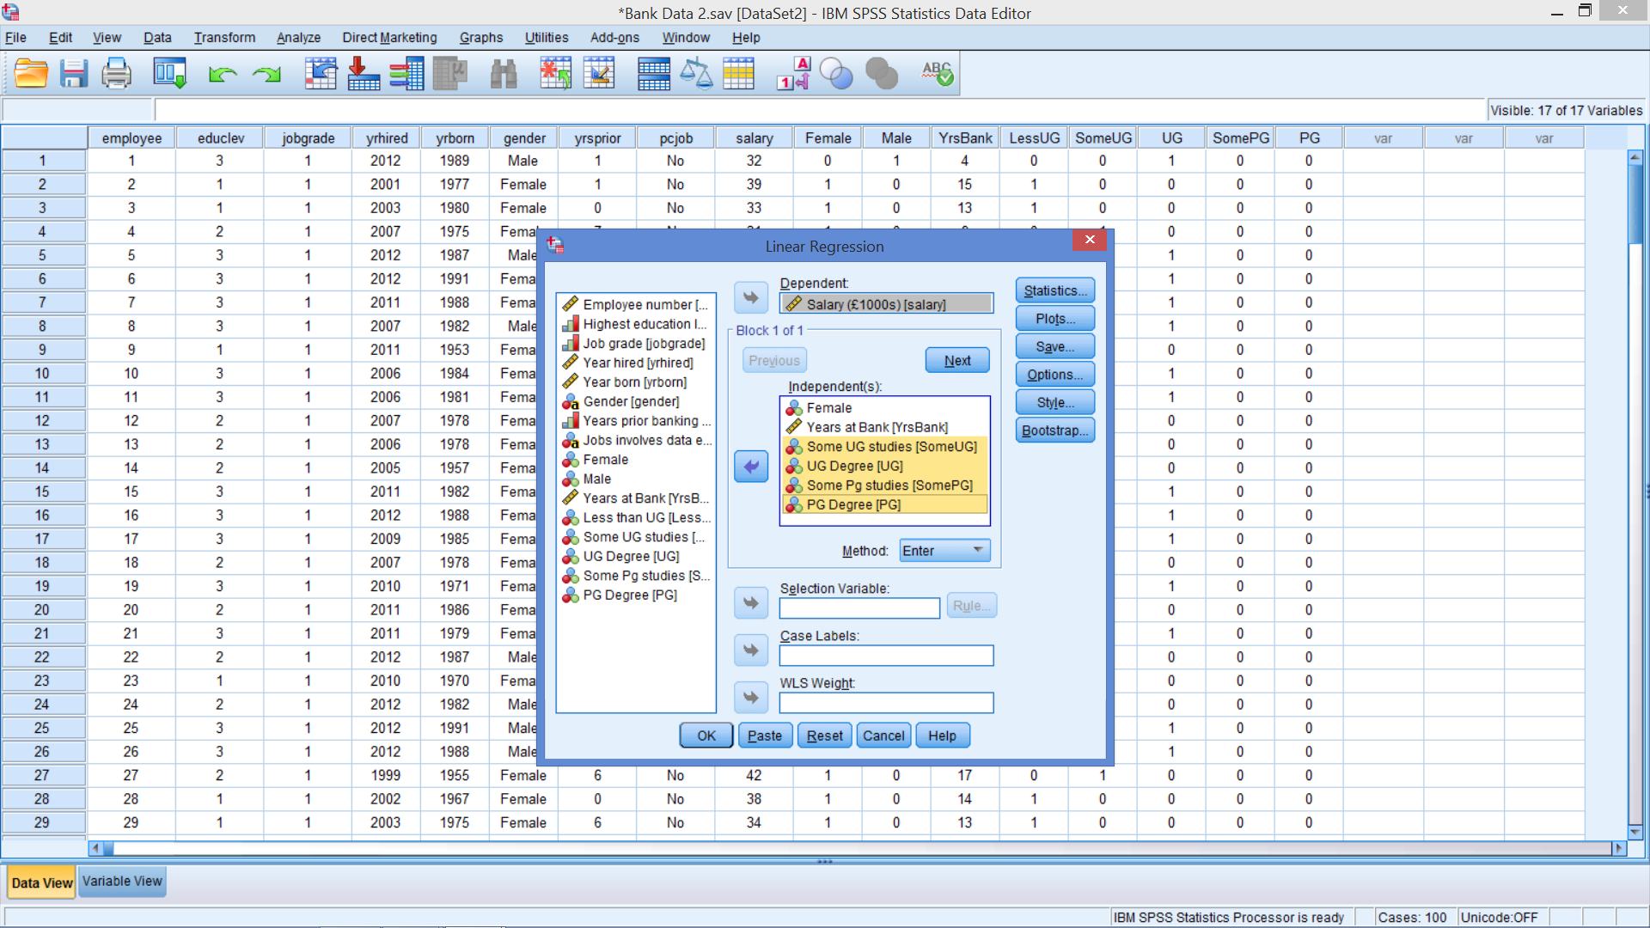
Add Education
Notes:
We next add education level to the equation by including four of the five education level dummies.
Although any four could be used, include Some UG (2) to PG Degree (5) so that the lowest level (1 = Less than UG) becomes the reference category.
We would expect this to lead to positive coefficients for these dummy variables, which are easier to interpret.
Remember, in recognizing multiple categories of one variable in regression:
Leave one category out of the regression
The one left out is called the reference category
Reference category captured in intercept
In previous regression (with female)
Gender captured by two variables: Female and Male
Female was included in the regression
Male was reference category (captured in intercept)
If you don’t leave one out, SPSS will – but it may not be as easy to interpret. Better for researcher to choose.

Slide 41
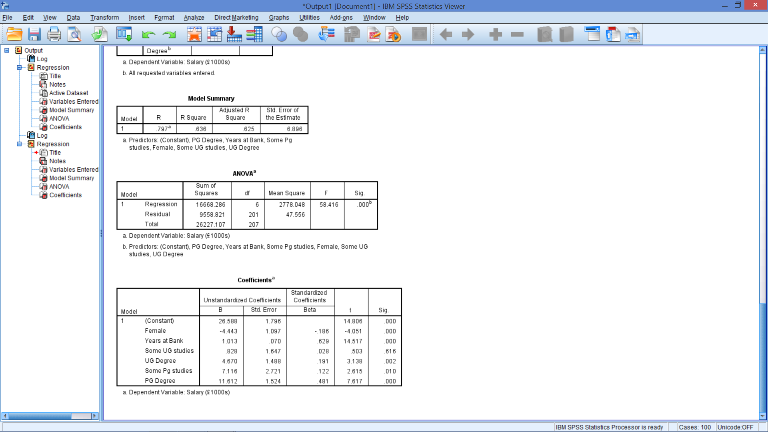
Add Education
Notes:
We next add education level to the equation by including four of the five education level dummies.
Although any four could be used, include Some UG (2) to PG Degree (5) so that the lowest level (1 = Less than UG) becomes the reference category.
We would expect this to lead to positive coefficients for these dummies, which are easier to interpret.
Remember, in recognizing multiple categories of one variable in regression:
Leave one category out of the regression
The one left out is called the reference category
Reference category captured in intercept
In previous regression (with female)
Gender captured in a variable with two categories
Male was reference category (captured in intercept)
If you don’t leave one out, SPSS will – but it may not be as easy to interpret. Better for researcher to choose.

Slide 42
Regression Output
Is it a good (better) model?
What is the model?
What is the interpretation?
What next?
F-statistic, R², Adj. R²
t-stats
How much salary gained for each year of employment?
Are coefficients significant?
$$\hat{Y}=26.588−4.443x_{1}+1.013x_{2}+.828x_{3}+4.670x_{4}+7.116x_{5}+11.612x_{6}$$
𝑌 ̂=26.588−4.443𝑥_1+1.013𝑥_2+.828𝑥_3+4.670𝑥_4+7.116𝑥_5+11.612𝑥_6
Define each variable
Are employees paid more for more education?
Are women paid less?
Notes:
Y = predicted salary
X1 = Female
X2 = Years at the Bank
X3 = Some UG studies
X4 = UG degree
X5 = Some PG studies
X6 = PG degree

Slide 43
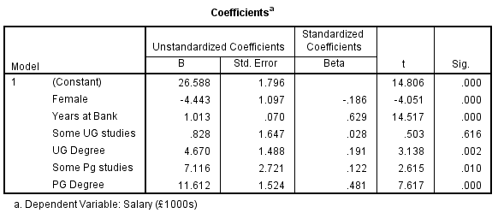
Look at Education Variable
Is the variable significant?
variable is significant ( see notes below)
What is the reference category?
The reference category is Less than UG
Where is it captured? The salary for this level is captured in the constant (intercept, b₀)
How do you interpret the coefficients on each level?
Each coefficient is the difference in salary for that highest level of education
What is difference in salary for PG degree?
£11,612
Notes:
The variable is significant
Note that even though one of the coefficients for education is not significant all must be included for predictions!
The variable education has 5 levels – all must be considered
If all are non-significant, then delete all of them – but only if all are not significant
The reference category is Less than UG
The salary for this level is captured in the constant (intercept, b₀)
Each coefficient is the difference in salary for that highest level of education
What is difference in salary for PG degree?
£11,612
Not the sum because each person has only 1 level of ‘highest’ education
Consider coding!

Slide 44
Regression Output
Is it a good (better) model?
What is the model?
What is the interpretation?
What next?
F-statistic, R², Adj. R²
t-stats
How much salary gained for each year of employment?
Are coefficients significant?
$$\hat{Y}=26.588−4.443x_{1}+1.013x_{2}+.828x_{3}+4.670x_{4}+7.116x_{5}+11.612x_{6}$$
𝑌 ̂=26.588−4.443𝑥_1+1.013𝑥_2+.828𝑥_3+4.670𝑥_4+7.116𝑥_5+11.612𝑥_6
Define each variable
Are employees paid more for more education?
Are women paid less?
Notes:
Y = predicted salary
X1 = Female
X2 = Years at the Bank
X3 = Some UG studies
X4 = UG degree
X5 = Some PG studies
X6 = PG degree

Slide 45
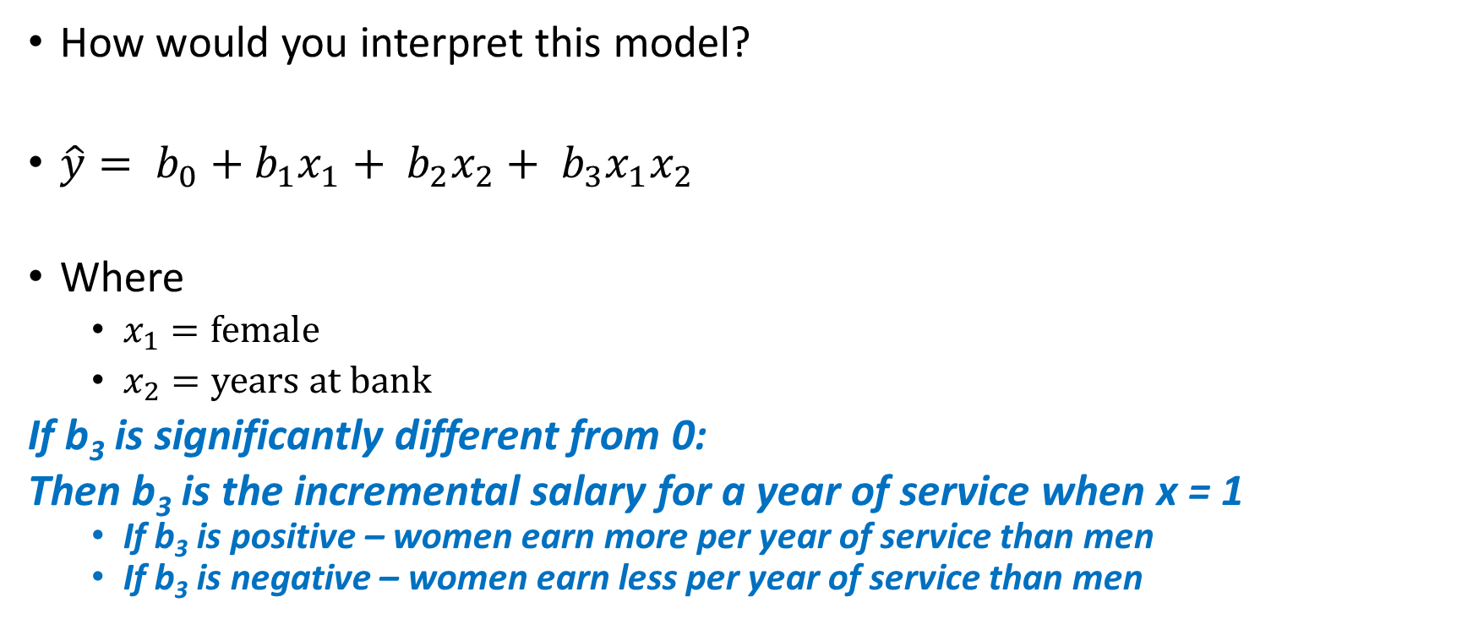
Food for Thought
How would you interpret this model?
$\hat{y}= b_{0}+b_{1}x_{1}+ b_{2}x_{2}+ b_{3}x_{1}x_{2}$
Where
$x_{1}=\text{female}$
$x_{2}=\text{years} \text{at} \text{bank}$
If b₃ is significantly different from 0:
Then b₃ is the incremental salary for a year of service when x = 1
If b₃ is positive – women earn more per year of service than men
If b₃ is negative – women earn less per year of service than men
Notes:
If b₃ is significantly different from 0:
Then b₃ is the incremental salary for a year of service when x = 1
If b₃ is positive – women earn more per year of service than men
If b₃ is negative – women earn less per year of service than men

Slide 46

In Class Problems Lets practice with cases.

Slide 47
Transforming Variables

Slide 48
Transforming Variables
Why transform a variable?
Need to correct for non-linearity
Need to improve predictive power or correlation
Detection of Need
Theory: Knowledge of situation and data
Examining the Data
New variables
Polynomials: Raising a variable to a power
Interaction terms: Multiplying two independent variables
Others:
Reciprocal of variable (1/x_{i}), Per capita variables, Log transformations of IVs or DVs
Notes:
Transforming variables means making new variables from the existing data.
The log transformation can be used to make highly skewed distributions less skewed. This can be valuable both for making patterns in the data more interpretable and for helping to meet the assumptions for using linear regression.

Slide 49
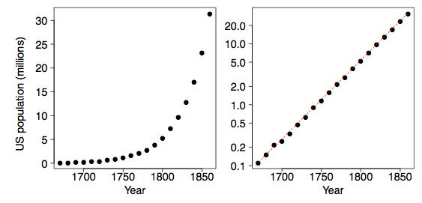
Log Transformation of DV
Notes:
Be careful of interpretation.

Slide 50
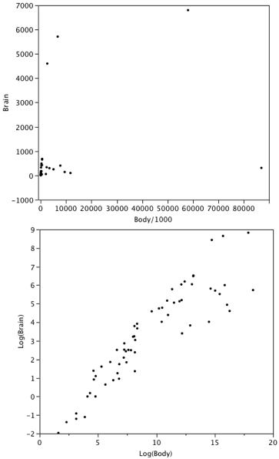
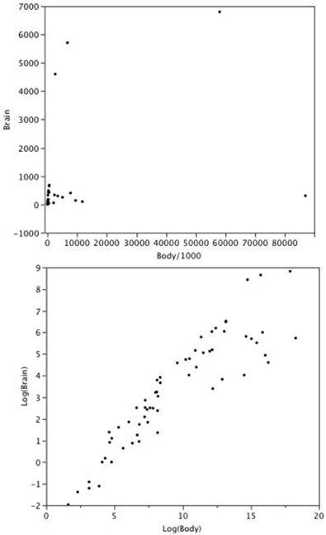
Log Transformation of DV & IV
Before
After
Notes:
The log transformation can be used to make highly skewed distributions less skewed. This can be valuable both for making patterns in the data more interpretable and for helping to meet the assumptions of inferential statistics.
Be careful of interpretation.

Slide 51
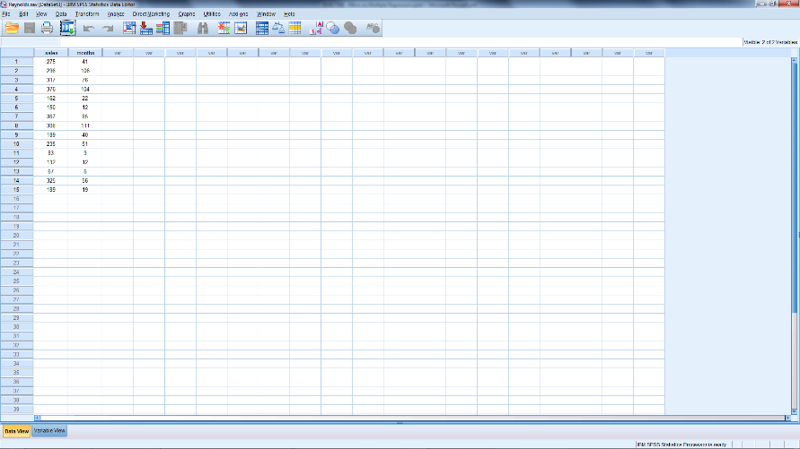
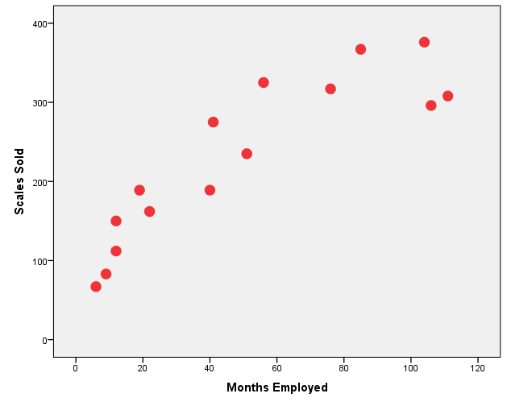
Example: Polynomial Graphs Legacy Dialogs Scatter / Dot Simple Scatter → Define X: Months Y: Sales
Open Reynolds.sav
Graph
Notes:
Graphs
Legacy Dialogs
Scatter / Dot
Simple Scatter → Define
X: Months
Y: Sales

Slide 52
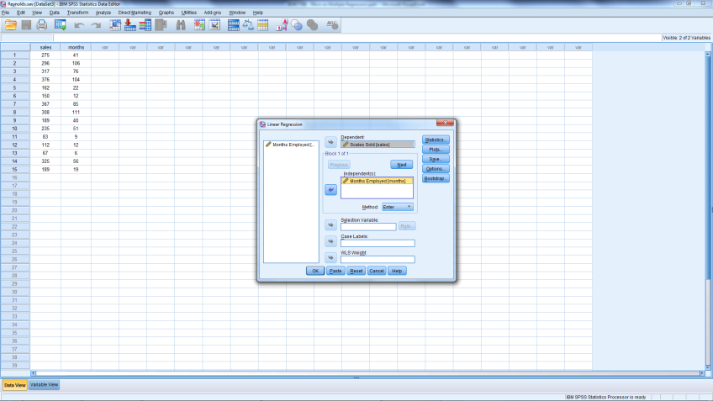
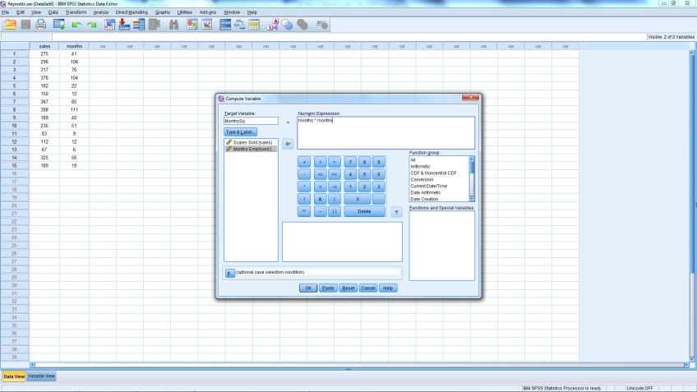
Example: Polynomial
Run Simple Regression
Ind: Months
Dep: Sales
Before running next regression
Transform
Compute
Target Variable: MonthSq
months*months
Use arrows
OK

Slide 53
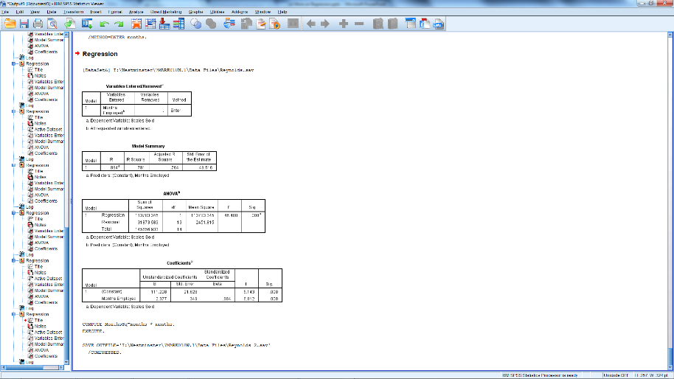
First Model
Is it a good model?
If so, what parameters are significant?
What is the model?

Slide 54
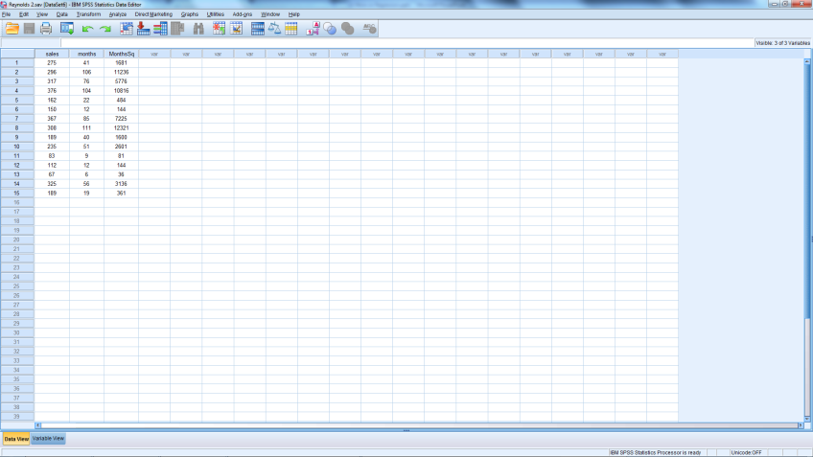
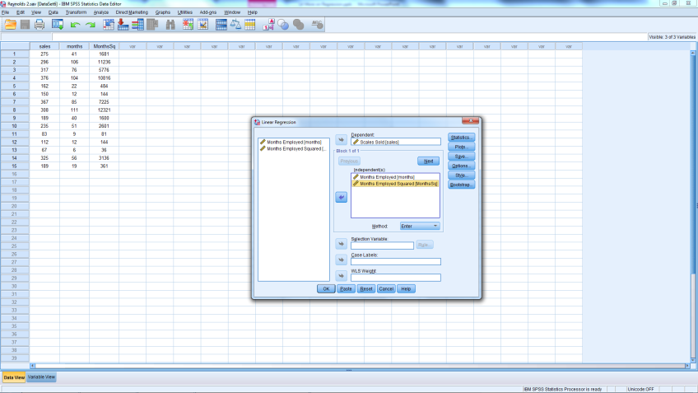
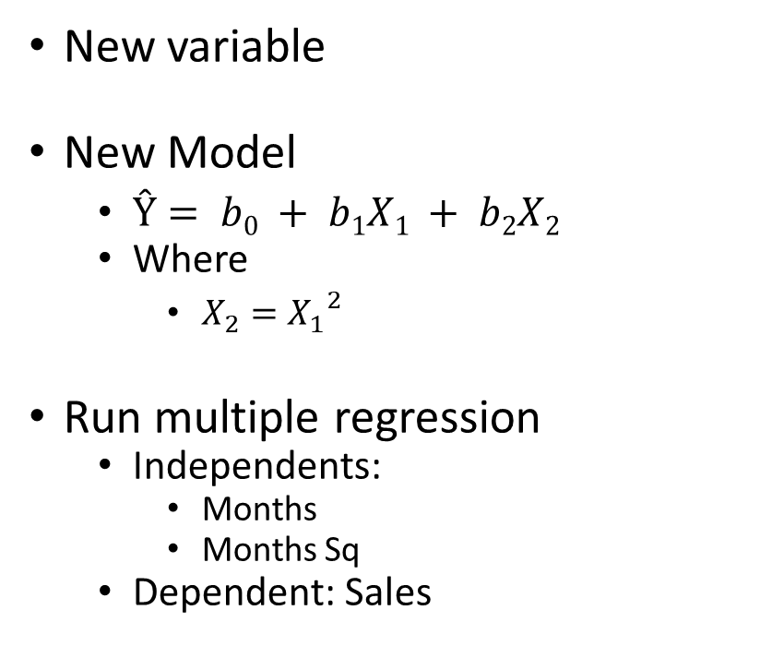
New Data View
New variable
New Model
$Ŷ= b0 + b1X1 + b2X2$
Where
$X_{2}={X_{1}}_{}^{2}$
Run multiple regression
Independents:
Months
Months Sq
Dependent: Sales

Slide 55
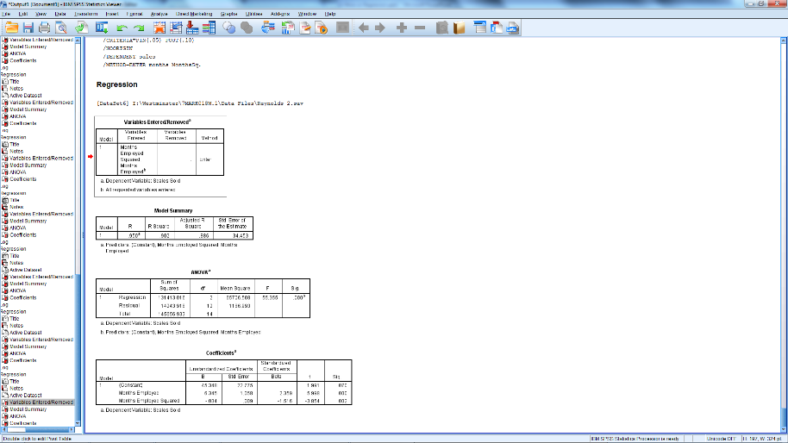
New Model
Is it a good model?
F-stat sig.?
Is it a better model?
R² higher?
Adj R² higher?
Coefficients?
Signs
Significance
Equation?
Ŷ= b₀ + b₁X₁ + b₂(X₂)
Predicted Sales = 45.348 + 6.345(months) - .034(months squared)
What does this mean?

Slide 56


Comparison of Regressions
Without Months Squared
Without Months Squared
Notes:
It appears that for exceptionally long service sales people, their productivity declines.

Slide 57
Wk 3 Bite 3 Cont…
Interaction Terms

Slide 58
What is an Interaction Term?
Product of two independent variables
New equation
What is the change in Y for a 1 unit change in
x₁, x₂, x₁x₂
$$\hat{Y}=b_{0}+b_{1}x_{1}+b_{2}x_{2}+b_{3}x_{1}x_{2}$$
𝑌 ̂=𝑏_0+𝑏_1 𝑥_1+𝑏_2 𝑥_2+𝑏_3 𝑥_1 𝑥_2
x₁?
x₂?
x₃ = x₁*x₂
Notes:
The presence of a significant interaction indicates that the effect of one predictor variable on the response variable is different at different values of the other predictor variable.
Note that one of the IVs could be a dummy variable

Slide 59

Interpretation
Assume
x₁ = advertising exp.
x₂ = price
The change in Y due to x₁ depends on the value of x₂.
The change in Y with a 1 unit change in x₁ produces a change of b₁ + b₃x₂
Notes:
Graph
Legacy Dialog
Line → Multiple
Summaries for Groups of Cases
Define
Lines Represent
Other Statistic (Mean)
Variable: Sales
Category: Advertising Expenditure
Define Lines By: Price
Each line has a different slope
Advertising’s impact on sales differs depending on the price

Slide 60

Creating an Interaction Term
Open Tyler.sav
Transform → Compute Variable
Target Variable: advprice
Numeric Expression: Adv*Price

Slide 61


Estimate 2 Models of Sales
Adv & Price
Adv & Price & Adv*Price

Slide 62


Which model is better?
w/o Adv*Price
w/ Adv*Price

Slide 63

Interpreting the Coefficients
What is the equation?
$\hat{Y}=b_{0}+b_{1}x_{1}+b_{2}x_{2}+b_{3}x_{1}x_{2}$
Pred. Sales = -275.833 + 175(Price) + 19.68(Adv) – 6.08(Adv*Price)
Change in Ŷ for Unit Change in Price
Price*175 – Price*(6.08*Advertising)
Price [ 175 – (6.08 * Advertising)]
Change in Ŷ for Unit Change in Advertising (£1000)
Adv*19.68 – Adv*(6.08*Price)
Adv [ 19.68 – (6.08 * Price)]
Notes:
Note that if the interaction term is significant, the main effects (x1 and x2) must be included in the model, even if not significant.

Slide 64
Note
If the interaction term is significant
Leave components (main effects) in estimated model
Even if not significant
If interaction term is not significant
Delete from model and re-estimate
Include only significant components main effects

Slide 65
What’s Next?
Topics
Problems in Regression
Readings
Malhotra, Birks, & Wills (2012) Chapter 21 pgs. 761 – 765

Slide 66
Problems in Regression
Outliers

Slide 67
Problem: Outliers
Errors in data entry
Valid but exceptional situation
Exceptional without likely explanation
Ordinary by individual variables but unusual combination

Slide 68

Residual Analysis
Open Bank Data 2.sav
Rerun the regression
Female
Yrs at Bank
Select Statistics box
Click Statistics Box
Under Residuals
Select Casewise Diagnostics
Notes:
Outlier: Data that are more extreme than majority
Detection
Looking at graphs of the data
With software
SPSS
Analyze / Regression / Linear
Statistics / Casewise diagnostics
Outliers > 3 standard deviations
EXCEL: residual plots
Usually a decision made by researcher

Slide 69

Regression Output

Slide 70

Residuals (Errors)
204 & 205
208

Slide 71
Problem: Outliers
Emp | Edu Level | Job Grade | Yr Hired | Yr Born | Gender | Yrs Prior | PC Job | Salary
204 | 3 | 6 | 1981 | 1955 | Male | 0 | No | 95
205 | 5 | 6 | 1979 | 1954 | Male | 0 | No | 97
208 | 5 | 6 | 1982 | 1953 | Female | 0 | No | 30
Fix data errors
Make decisions about:
Unexplained exceptional observations
Exceptional yet valid observations
Guard against deleting those that are different, while representative

Slide 72
Problems
Multicollinearity

Slide 73

What is Multicollinearity?
Notes:
Multicollinearity occurs when independent variables are so highly correlated with each other that it is difficult to come up with reliable estimates of their individual regression coefficients.
When two variables are highly correlated, they are basically measuring the same phenomenon or construct. In other words, when two variables are highly correlated, they both convey essentially the same information.
Essentially, one variable cannot be held constant while the impact of the other on the dependent variable is estimated.

Slide 74
Showtime Movie Open data Showtime.sav
Open data file Showtime.Sav
Predict weekly gross revenue as a function of advertising
Run correlations of all three variables
Run two simple regressions
Predict revenue from TV advertising
Predict revenue from newspaper advertising
Run one multiple regression
Predict revenue
From both types of advertising

Slide 75

Correlations

Slide 76
Regression Output
Feature | Model 1 | Model 2 | Model 3
F-statistic (Sig.) | 17.195 (.006) | 74.142 (.000) | 36.562 (.001)
R² | .741 | .925 | .936
Adj R² | .698 | .913 | .910
Television Adv. (Sig.) | 1.595 (.006) |  | -.540 (.399)
Newspaper Adv. (Sig.) |  | -1.961 (.000) | -2.516 (.011)

Slide 77
Regression Output
Feature | Model 1 | Model 2 | Model 3
F-statistic (Sig.) | 17.195 (.006) | 74.142 (.000) | 36.562 (.001)
R² | .741 | .925 | .936
Adj R² | .698 | .913 | .910
Television Adv. (Sig.) | 1.595 (.006) |  | -.540 (.399)
Newspaper Adv. (Sig.) |  | -1.961 (.000) | -2.516 (.011)

Slide 78

Effects of Multicollinearity
Parameter Estimates
Unstable
May have wrong sign
Parameters appear unhelpful
May appear insignificant
May not reject null hypotheses

Slide 79

Identification
Redo Multiple Regression
Before hitting OK
Select the Statistics box
Check Collinearity diagnostics
Continue
OK

Slide 80

Identification
Tolerance
Amount of variation not explained by other IVs
Similar to 1 – R² → Want this to be high
VIF ≡ Variance Inflation Factor = 1 / Tolerance
VIF > 10 is common threshold
Notes:
Collinearity Diagnostics
Tolerance: amount of variation not explained by other independent variables
Intuitively similar to 1-R²
Want this to be high – low indicates a problem
As R2 increases – Tolerance decreases
VIF ≡ Variance Inflation Factor = 1/ tolerance
VIF > 10 is common threshold (without other evidence)
(Don’t worry about other diagnostics provided)

Slide 81
Detecting Multicollinearity
Correlations between IVs > .9 or < -.9
Unexpected signs on estimated coefficients
Large F (or Adj. R²), small t
VIF nearing or > 10
Cumulative Impact of all Indications
Notes:
No one piece of evidence is sufficient – addressing multicollinearity depends on the accumulation of evidence
Correlation among independent variables
Not really independent variables
Can’t hold one constant and assess impact of another
Large F, small t indicates that there is still a good fit of the regression line (high Adj. R²), but the individual parameter estimates are not good

Slide 82
What to do – The Task
Assess degree of multicollinearity
Determine the impact on results & necessary remedies
Keep your own objective in mind

Slide 83
What to do – The Remedy
Omit one or more of the highly correlated variables
Use the model for prediction or forecasting only
Make no attempt to interpret the coefficients
Which one?
Rerun model

Slide 84
In-class Exercise Open Restaurant.sav
Open Restaurant.sav again
Assume the Year measures length of time in business
Run Regressions predicting sales
Does Multicollinearity appear to be present?
If so, what next?
From Prev Adv., Adv., Population
Then add Year
Check Collinearity Diagnostics
How do you know?
Anything suspicious?
Run correlation including year

Slide 85
Try these on the data
Previous Output
Regression Output with Year
Correlations

Slide 86
Multicollinearity Evidence
From correlations
Correlation between Year and Population = .986
Regression Output – Increased Adj. R²
Year is not significant
Now negative sign
Now insignificant
VIF
Population >>> 10
Year >>> 10
What should be done?
Use as is for predictions
Update model without one or more of collinear variables
Population
Notes:
From correlations
Correlation between Year and Population = .986
Regression Output – Increased Adj. R²
Year is not significant
Population
Now negative sign
Now insignificant
VIF
Population >>> 10
Year >>> 10
What should be done?
Use as is for predictions
Update model without one or more of collinear variables

